Slide 2
The Safe Food Handler
Objectives:
  Avoiding personal behaviors that can contaminate food
  Washing and caring for hands
  Dressing for work and handling work clothes
  Limiting where staff can eat, drink, smoke, and chew gum or tobacco
  Preventing staff who may be carrying pathogens from working with or around food, or from working in the operation
3-2
Notes:
Instructor Notes
Discuss the topic objectives with the class.

Slide 3
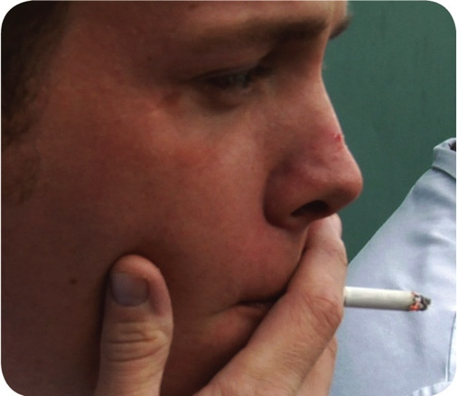
How Food Handlers Can Contaminate Food
Food handlers can contaminate food when they:
  Have a foodborne illness
  Have wounds that contain a pathogen
  Sneeze or cough
  Have contact with a person who is sick
  Touch anything that may contaminate their hands and don’t wash them
  Have symptoms such as diarrhea, vomiting, or jaundice—a yellowing of the eyes or skin
3-3
Notes:
Instructor Notes
With some illnesses, a person may infect others before showing any symptoms. For example, a person could spread hepatitis A for weeks before having any symptoms.
With other illnesses, a person may infect others for days or even months after symptoms are gone. Norovirus can be spread for days after symptoms have ended.
Some people carry pathogens and infect others without ever getting sick themselves. These people are called carriers. The bacteria Staphylococcus aureus is carried in the nose of 30 to 50 percent of healthy adults. About 20 to 35 percent of healthy adults carry it on their skin. Food handlers transfer this type of bacteria to food when they touch the infected areas of their bodies and then touch food without washing their hands.

Slide 4
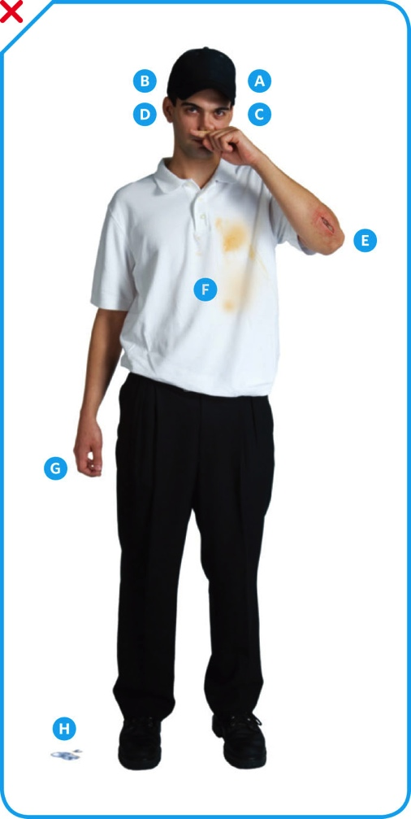
How Food Handlers Can Contaminate Food
Actions that can contaminate food:
Scratching the scalp
Running fingers through hair
Wiping or touching the nose
Rubbing an ear
Touching a pimple or infected wound
Wearing a dirty uniform
Coughing or sneezing into the hand
Spitting in the operation
3-4
Notes:
Instructor Notes
People often do things that can spread pathogens without knowing it. To avoid causing a foodborne illness, food handlers must pay close attention to what they do with their hands and avoid the actions indicated in the slide.

Slide 5
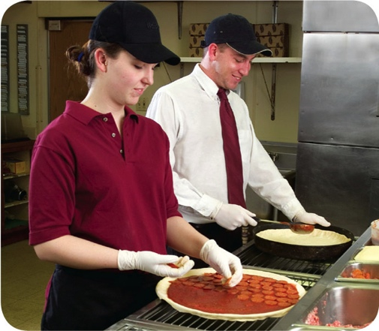
Managing a Personal Hygiene Program
Managers must focus on the following:
  Creating personal hygiene policies
  Training food handlers on personal hygiene policies and retraining them regularly
  Modeling correct behavior at all times
  Supervising food safety practices
  Revising personal hygiene policies when laws or science change
3-5
Notes:
Instructor Notes
Don’t underestimate your role in a personal hygiene program. You have many responsibilities to help make the program work. Some of these are highlighted in the slide.

Slide 6
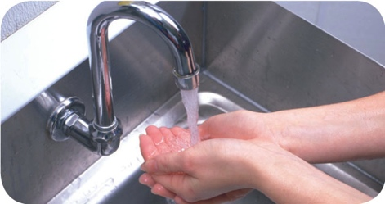
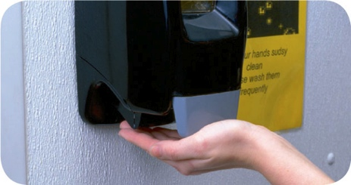
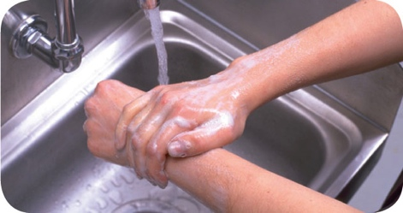
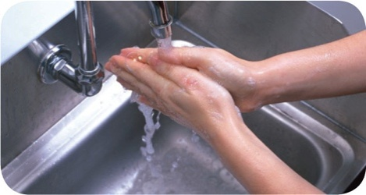
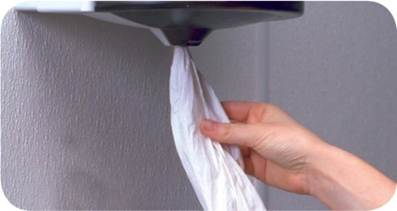
Handwashing
How to wash hands (should take at least 20 seconds):
1. Wet hands and arms. Use running water as hot as you can comfortably stand. It should be at least 100°F(38°C).
2. Apply soap. Apply enough to build up a good lather.
3. Scrub hands and arms vigorously. Scrub them for 10 to 15 seconds. Clean under fingernails and between fingers.
4. Rinse hands and arms thoroughly. Use running warm water.
5. Dry hands and arms. Use a single-use paper towel or hand dryer. Consider using a paper towel to turn off the faucet and open the restroom door.
3-6
Notes:
Instructor Notes
Handwashing is the most important part of personal hygiene. It may seem like an obvious thing to do. Even so, many food handlers do not wash their hands the correct way or as often as they should.
You must train your food handlers to wash their hands, and then you must monitor them.

Slide 7
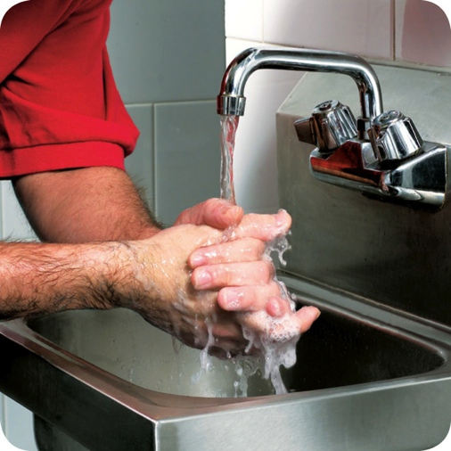
When to Wash Hands
Food handlers must wash their hands before they start work and after:
  Using the restroom
  Handling raw meat, poultry, and
  seafood (before and after)
  Touching the hair, face, or body
  Sneezing, coughing, or using
  a tissue
  Eating, drinking, smoking, or chewing gum or tobacco
  Handling chemicals that might
  affect food safety
3-7

Slide 8
When to Wash Hands
Food handlers must wash their hands after:
  Taking out garbage
  Clearing tables or busing dirty dishes
  Touching clothing or aprons
  Handling money
  Leaving and returning to the kitchen/prep area
  Handling service animals or aquatic animals
  Touching anything else that may contaminate hands
3-8

Slide 9
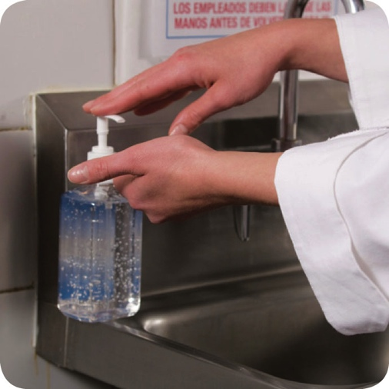
Hand Antiseptics
Hand antiseptics:
  Liquids or gels used to lower the number
  of pathogens on skin
  Must comply with the CFR and
  FDA standards
  Should be used only after handwashing
  Must NEVER be used in place of handwashing
  Should be allowed to dry before touching food or equipment
3-9
Notes:
Instructor Notes

Slide 10
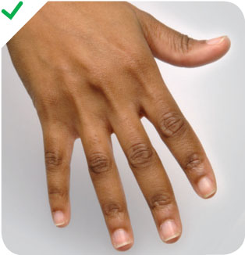
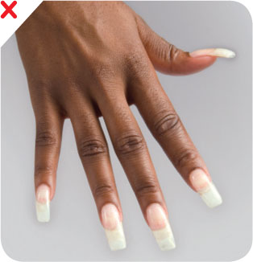
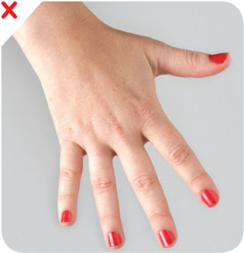
Hand Care
Requirements for food handlers:
Keep fingernails
short and clean
Do NOT wear
false nails
Do NOT wear
nail polish
3-10
Notes:
Instructor Notes
Long fingernails may be hard to keep clean and can rip gloves. They can also chip and become physical contaminants.
Fingernails should be kept trimmed and filed. This will allow nails to be cleaned easily. Ragged nails can be hard to keep clean. They may also hold pathogens and break off—becoming physical contaminants.
Do not wear false fingernails. They can be hard to keep clean. False fingernails also can break off into food. Some local regulatory authorities allow false nails if single-use gloves are worn.
Do not wear nail polish. It can disguise dirt under nails and may flake off into food. Some regulatory authorities allow polished nails if single-use gloves are worn.

Slide 11
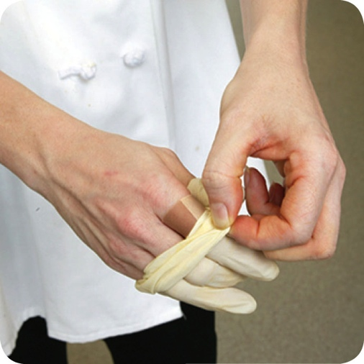
Infected Wounds or Cuts
Infected wounds or cuts:
  Contain pus
  Must be covered to prevent pathogens
  from contaminating food and food-contact surfaces
How a wound is covered depends on
where it is located:
  Cover wounds on the hand or wrist with an
  impermeable cover, (i.e. bandage or finger cot) and
  then a single-use glove
  Cover wounds on the arm with an impermeable cover,
  such as a bandage
  Cover wounds on other parts of the body with a dry,
  tight-fitting bandage
3-11
Notes:
Instructor Notes

Slide 12
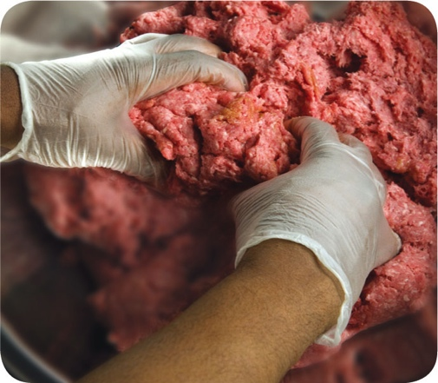
Single-Use Gloves
Single-use gloves:
  Should be used when handling
  ready-to-eat food
    Except when washing produce
    Except when handling ready-to-eat ingredients for a dish that will be cooked
  Must NEVER be used in place
  of handwashing
  Must NEVER be washed and reused
  Must fit correctly
3-12
Notes:
Instructor Notes
Single-use gloves can help keep food safe by creating a barrier between hands and food. Gloves should be worn when handling ready-to-eat food. The exceptions include when washing produce, or when handling ready-to-eat ingredients for a dish that will be cooked to the correct internal temperature.
Hands must be washed before putting on gloves and when changing to a new pair.
Make sure you provide different glove sizes. Gloves that are too big will not stay on. Those that are too small will tear or rip easily.
Some food handlers and customers may be sensitive to latex. Consider providing gloves made from other materials.

Slide 13
Single-Use Gloves
How to use gloves:
  Wash and dry hands before putting gloves on
  Select the correct glove size
  Hold gloves by the edge when putting them on
  Once gloves are on, check for rips or tears
  NEVER blow into gloves
  NEVER roll gloves to make them easier to put on
3-13
Notes:
Instructor Notes
Avoid contaminating gloves when putting them on.

Slide 14
Single-Use Gloves
When to change gloves:
  As soon as they become dirty or torn
  Before beginning a different task
  After an interruption, such as taking a phone call
  After handling raw meat, seafood, or poultry and before handling ready-to-eat food
3-14

Slide 15
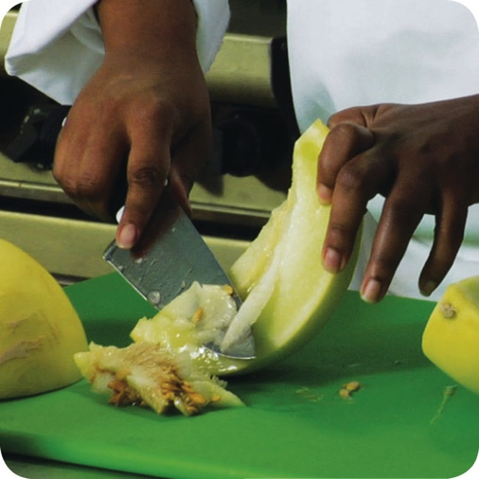
Bare-Hand Contact with Ready-to-Eat Food
Bare-hand contact with ready-to-eat food must be avoided:
  Some jurisdictions allow it but require:
    Policies on staff health
    Training in handwashing and personal hygiene practices
  NEVER handle ready-to-eat food with bare hands when you primarily serve a high-risk population
3-15
Notes:
Instructor Notes
Food can become contaminated when it has been handled with bare hands. This is especially true when hands have not been washed correctly or have infected cuts or wounds. For this reason, do not handle ready-to-eat food with bare hands.
Never handle ready-to-eat food with bare hands if you primarily serve a high-risk population.
Some regulatory authorities allow bare-hand contact with ready-to- eat food. If your jurisdiction allows this, you must have specific policies in place about staff health. You must also train staff in handwashing and personal hygiene practices.

Slide 16
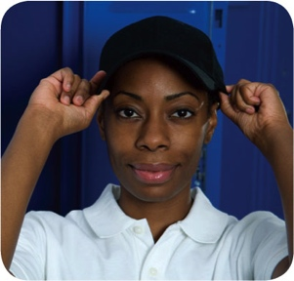
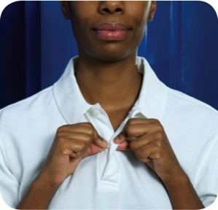
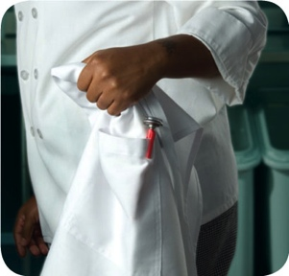
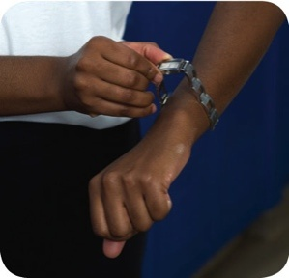
Work Attire
Food handlers must:
  Wear a clean hat or other
  hair restraint
  Wear clean clothing daily
  Remove aprons when leaving food-preparation areas
  Remove jewelry from hands and arms before prepping food or when working around prep areas
3-16
Notes:
Instructor Notes
Do not wear hair accessories that could become physical contaminants. Hair restraints should be limited to items that keep hands out of hair, and hair out of food. Food handlers with facial hair should wear a beard restraint.
False eyelashes can become physical contaminants and should not be worn.
If possible, food handlers should change into work clothes at work. Dirty clothing stored in the operation must be kept away from food and prep areas. You can do this by placing them in nonabsorbent containers or washable laundry bags. This includes dirty aprons, chef coats, and uniforms.
Never wipe your hands on aprons.
Food handlers cannot wear jewelry when prepping food or when working around prep areas. That includes rings (except for a plain band), bracelets (including medical bracelets), and watches. Companies may also require food handlers to remove other types of jewelry. This may include earrings, necklaces, and facial jewelry. Servers may wear jewelry if allowed by company policy.

Slide 17
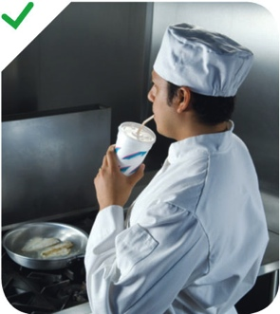
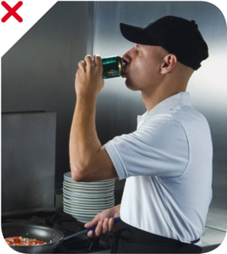
Eating, Drinking, Smoking, and Chewing Gum or Tobacco
Food handlers must not:
  Eat, drink, smoke, or chew gum or tobacco
When:
  Prepping or serving food
  Working in prep areas
  Working in areas used to clean utensils and equipment
3-17
Notes:
Instructor Notes
Small droplets of saliva can contain thousands of pathogens. In the process of eating, drinking, smoking, or chewing gum or tobacco, saliva can be transferred to hands or directly to food being handled. That’s why food handlers must not eat, drink, smoke, or chew gum or tobacco when performing the tasks indicated in the slide.
Some regulatory authorities allow food handlers to drink from a covered container while in prep and dishwashing areas.

Slide 18
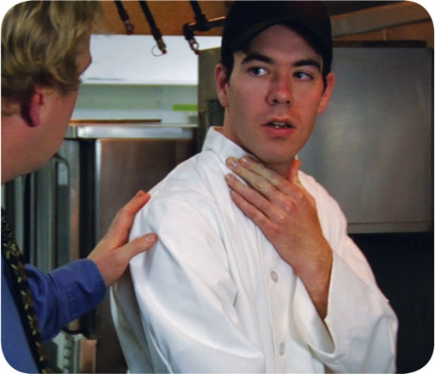
Handling Staff Illnesses
  If:
  The food handler has a sore throat with a fever
Then:
  Restrict the food handler from working with or around food
  Exclude the food handler from the operation if you primarily serve a high-risk population
  A written release from a medical practitioner is required before returning to work
3-18
Notes:
Instructor Notes
You must encourage your staff to report any health problems before they come to work. This includes newly hired staff who haven’t started working yet.
Staff should also let you know immediately if they get sick while working. Your regulatory authority may ask you to prove you have made staff aware of this policy.
When food handlers are sick, you may need to restrict them from working with or around food. Sometimes, you may need to exclude them from working in the operation.

Slide 19

Handling Staff Illnesses
  If:
  The food handler has at least one of these symptoms
  Vomiting
  Diarrhea
  Then:
Exclude the food handler from the operation
Before returning to work, food handlers who vomited
or had diarrhea must meet one of these requirements
  Have had no symptoms for at least 24 hours
  Have a written release from a medical practitioner
3-19

Slide 20
Handling Staff Illnesses
If:
  The food handler has jaundice
Then:
  Food handlers with jaundice must be reported to the regulatory authority
  Exclude food handlers who’ve had jaundice for less than
  7 days from the operation
  Food handlers must have a written release from a
  medical practitioner and approval from the regulatory authority before returning to work
3-20

Slide 21
Handling Staff Illnesses
If:
  The food handler has been diagnosed with a foodborne illness
  caused by one of these pathogens and has symptoms
    Hepatitis A
    Salmonella Typhi
    Enterohemorrhagic and shiga toxin-producing E. coli
    Norovirus
    Shigella spp.
Then:
  Exclude the food handler from the operation
  Work with the food handler’s medical practitioner and/or the local regulatory authority to decide when the person can go back to work
3-21
Notes:
Instructor Notes
Some food handlers diagnosed with these foodborne illnesses may not experience the usual signs or their symptoms may be over. Work with the local regulatory authority to determine whether the food handler must be excluded from the operation or restricted from working with or around food, and when the exclusion or restriction can be removed.
Remember these are only guidelines, working with your regulatory authority will help you determine the best course of action.

Slide 23
The Flow of Food
Objectives:
  How to prevent cross-contamination
  How to prevent time-temperature abuse
  How to use the correct kinds of thermometers to take temperatures
4-2
Notes:
Instructor Notes
Discuss the topic objectives with the class.

Slide 24
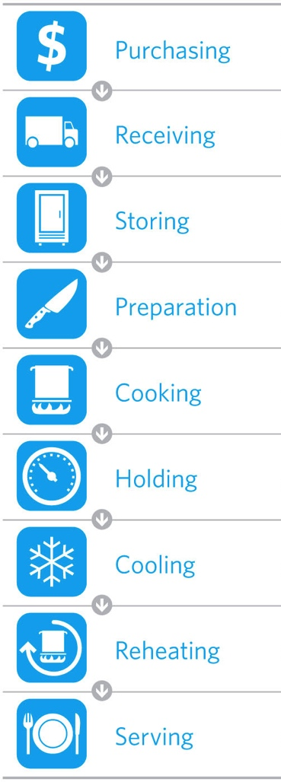
The Flow of Food
To keep food safe throughout the flow of food:
  Prevent cross-contamination
  Prevent time-temperature abuse
4-3
Notes:
Instructor Notes
You are responsible for the safety of the food at every point in this flow. For example, a frozen food might be safe when it leaves the processor’s plant. However, on the way to the supplier’s warehouse, the food might thaw. Once in your operation, the food might not be stored correctly, or it might not be cooked to the correct internal temperature. These mistakes can add up and cause a foodborne illness.

Slide 25
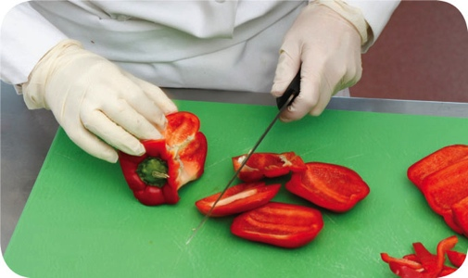
Preventing Cross-Contamination
Separate equipment:
  Use separate equipment for each type of food
Clean and sanitize:
  Clean and sanitize all work surfaces, equipment, and utensils after each task
4-4
Notes:
Instructor Notes
Each type of food should have separate equipment. For example, use one set of cutting boards, utensils, and containers for raw poultry. Use another set for raw meat. Use a third set for produce. Colored cutting boards and utensil handles can help keep equipment separate. The color tells food handlers which equipment to use with each food item. You might use yellow for raw chicken, red for raw meat, and green for produce, as the prep chef is doing in the photo.
Clean and sanitize all work surfaces, equipment, and utensils after each task. When you cut up raw chicken, for example, you cannot get by with just rinsing the equipment. Pathogens such as Salmonella spp. can contaminate food through cross-contamination. To prevent this, you must wash, rinse, and sanitize equipment.

Slide 26
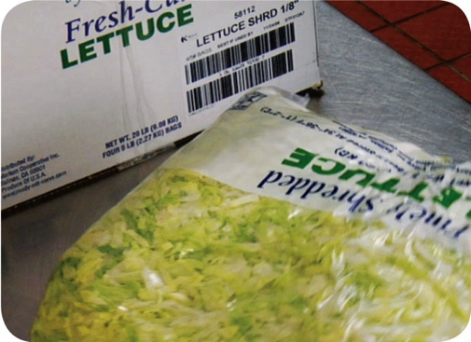
Preventing Cross-Contamination
Prep food at different times:
  Prepare raw meat, fish, and poultry at different times than ready-to-eat food (when using the same prep table)
Buy prepared food:
  Buy food items that don’t require much prepping or handling
4-5
Notes:
Instructor Notes
If you need to use the same table to prep different types of food, prep raw meat, fish, and poultry; and ready-to-eat food at different times. You must clean and sanitize work surfaces and utensils between each type of food. For example, by prepping ready-to-eat food before raw food, you can minimize the chance for cross-contamination.
Buy food that doesn’t require much prepping or handling. For example, you could buy precooked chicken breasts or chopped lettuce, as shown in the photo.

Slide 27
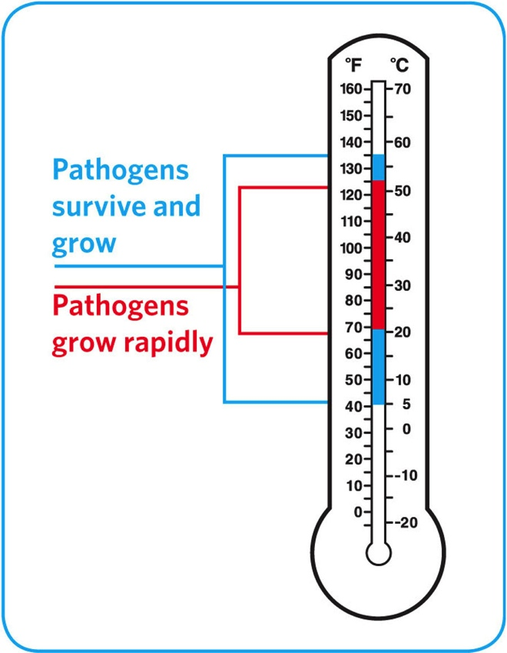
Preventing Time-Temperature Abuse
Time-temperature control:
  Food held in the range of 41°F and 135°F (5°C and 57°C) has been time-temperature abused
  Food has been time-temperature abused whenever it is handled in the following ways
    Cooked to the wrong internal temperature
    Held at the wrong temperature
    Cooked or reheated incorrectly
4-6
Notes:
Instructor Notes
Most foodborne illnesses happen because TCS food has been time-temperature abused. Remember, TCS food has been time-temperature abused any time it remains between 41°F and 135°F (5°C and 57°C). This is called the temperature danger zone because pathogens grow in this range. But most pathogens grow much faster between 70°F and 125°F (21°C and 52°C).
Food is being temperature abused whenever it is handled in the following ways: cooked to the wrong internal temperature, held at the wrong temperature, or cooled or reheated incorrectly.
The longer food stays in the temperature danger zone, the more time pathogens have to grow. To keep food safe, you must reduce the time it spends in this temperature range. If food is held in this range for four or more hours, you must throw it out.

Slide 28
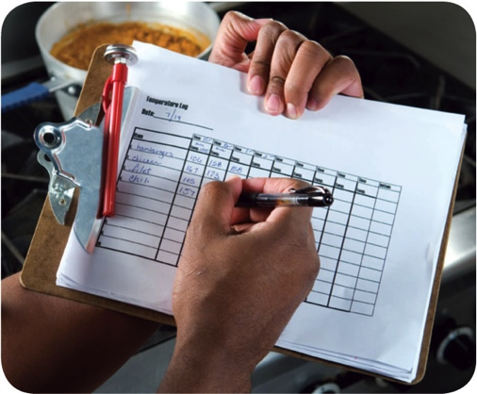
Preventing Time-Temperature Abuse
Avoid time-temperature abuse:
  Monitor time and temperature
  Make sure the correct kinds of thermometers are available
  Regularly record temperatures and the times they are taken
  Minimize the time that food spends in the temperature danger zone
  Take corrective actions if time-temperature standards are not met
4-7
Notes:
Instructor Notes
Learn which food items should be checked, how often, and by whom.
Use timers in prep areas to check how long food is in the temperature danger zone.
A policy limiting the amount of food that can be removed from a cooler when prepping it can limit the time food spends in the temperature danger zone.
Reheating soup that was being held below 135°F (57°C) is an example of a corrective action.

Slide 29
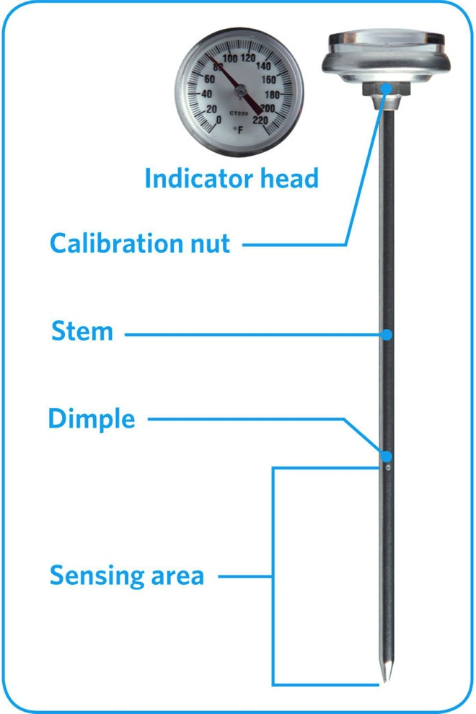
Monitoring Time and Temperature
Bimetallic stemmed thermometer
4-8
Notes:
Instructor Notes
A bimetallic stemmed thermometer can check temperatures from 0˚F to 220˚F (–18˚C to 104˚C).
This thermometer measures temperature through its metal stem. When checking temperatures, insert the stem into the food up to the dimple. You must do this because the sensing area of the thermometer goes from the tip of the stem to the dimple. This trait makes this thermometer useful for checking the temperature of large or thick food. It is usually not practical for thin food, such as hamburger patties.
The calibration nut is used to adjust the thermometer to make it accurate.

Slide 30
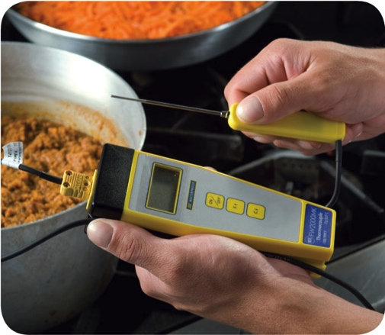
Monitoring Time and Temperature
Thermocouples and thermistors:
  Measure temperature through a metal probe
  Display temperatures digitally
  Come with interchangeable probes
    Immersion probe
    Surface probe
    Penetration probe
    Air probe
  Have a sensing area on the tip of their probe
4-9
Notes:
Instructor Notes
The sensing area on thermocouples and thermistors is on the tip of their probe. This means you don’t have to insert them into the food as far as bimetallic stemmed thermometers to get a correct reading. Thermocouples and thermistors are good for checking the temperature of both thick and thin food.
Thermocouples and thermistors come in several styles and sizes. Many come with different types of probes.
Immersion probes are used to check the temperature of liquids such as soups, sauces, and frying oil.
Surface probes are used to check the temperature of flat cooking equipment such as griddles.
Penetration probes are used to check the internal temperature of food. Small-diameter probes should be used to check the internal temperature of thin food such as meat patties and fish fillets.
Air probes are used to check the temperature inside coolers and ovens.
.

Slide 31
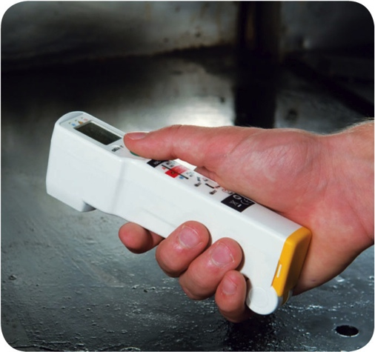
Monitoring Time and Temperature
Infrared (laser) thermometers:
  Used to measure the surface temperature of food and equipment
  Hold as close to the food or equipment as possible
  Remove anything between the thermometer and the food, food package, or equipment
  Follow manufacturers’ guidelines
4-10
Notes:
Instructor Notes
These thermometers cannot measure air temperature or the internal temperature of food.
Hold the thermometer as close as possible to the food, food package, or equipment without touching it. Do NOT take readings through glass or metal, such as stainless steel or aluminum.
Always follow the manufacturers’ guidelines. This should give you the most accurate readings.

Slide 32
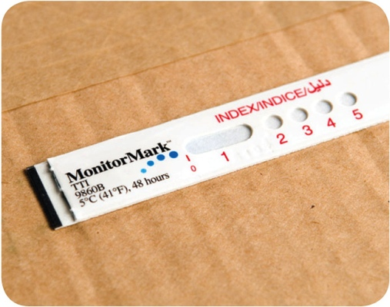
Monitoring Time and Temperature
  Time-temperature indicators (TTI):
  Monitor both time and temperature
  Are attached to packages by the supplier
  A color change appears on the device when
  time-temperature abuse has occurred
Maximum registering tape:
  Indicates the highest temperature reached
  during use
  Used where temperature readings cannot
  be continuously observed
4-11
Notes:
Instructor Notes
Some devices monitor both time and temperature. The time-temperature indicator (TTI) is an example. These tags are attached to packaging by the supplier. A color change appears in the window if the food has been time-temperature abused during shipment or storage. This color change is not reversible, so you know if the food has been abused.
Some suppliers place temperature-recording devices inside their delivery trucks. These devices constantly check and record temperatures. You can check the device during receiving to make sure food was at safe temperatures while it was being shipped.
Other tools are available that can help you monitor temperature. A maximum registering thermometer is one type. This thermometer indicates the highest temperature reached during use and is used where temperature readings cannot be continuously observed. It works well for checking final rinse temperatures of dishwashing machines.

Slide 33
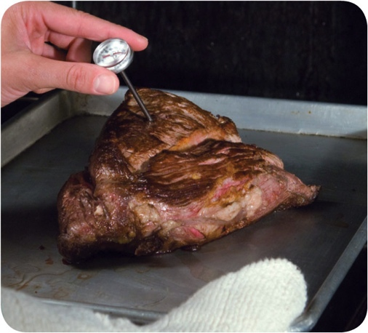
General Thermometer Guidelines
When using thermometers:
  Wash, rinse, sanitize, and air-dry thermometers before and after using them
  Calibrate them before each shift to
  ensure accuracy
  Make sure thermometers used to measure the temperature of food are accurate to
  +/- 2°F or +/- 1°C
  Only use glass thermometers if they are enclosed in a shatterproof casing
4-12
Notes:
Instructor Notes
Thermometers should be washed, rinsed, sanitized, and air-dried before and after each use to prevent cross-contamination. Be sure the sanitizing solution you use is for food-contact surfaces.
Thermometers can lose their accuracy when they are bumped or dropped. It can also happen when they go through severe temperature change. When this happens, the thermometer must be calibrated, or adjusted, to give a correct reading. Make sure your thermometers are accurate by calibrating them regularly. You should do this before each shift. You should also do this before the first delivery arrives. Some thermometers cannot be calibrated and must be replaced. Others will need to be sent back to the manufacturer for calibration. Follow the manufacturer’s directions regarding calibration.
Glass thermometers, such as candy thermometers, can be a physical contaminant if they break. They can only be used when enclosed in a shatterproof casing.

Slide 34
General Thermometer Guidelines
When using thermometers:
  Insert the thermometer stem or
  probe into thickest part of the product
  (usually the center)
  Take more than one reading in different spots
  Wait for the thermometer reading to steady before recording the temperature
4-13
Notes:
Instructor Notes
When checking the temperature of food, insert the probe into the thickest part of the food, as shown in the photo. This is usually in the center. Also take another reading in a different spot. The temperature may vary in different areas. Before recording a temperature, wait for the thermometer reading to steady. Wait at least 15 seconds after you insert the stem or the probe into the food.

Slide 36
The Flow of Food: Purchasing, Receiving, and Storage
Objectives:
  Purchase food from approved, reputable suppliers
  Use criteria to accept or reject food during receiving
  Label and date food
  Store food and nonfood items to prevent time-temperature abuse and contamination
5-2
Notes:
Instructor Notes
Discuss the topic objectives with the class.

Slide 37
General Purchasing and Receiving Principles
Purchase food from approved, reputable suppliers:
  Have been inspected
  Meet all applicable local, state, and federal laws
Arrange deliveries so they arrive:
  When staff has enough time to do inspections
  When they can be correctly received
5-3
Notes:
Instructor Notes
Food must be purchased from approved, reputable suppliers. These suppliers have been inspected and can show you an inspection report. They also meet all applicable local, state, and federal laws. This applies to all suppliers in the supply chain. Your operation’s chain can include growers, shippers, packers, manufacturers, distributors (trucking fleets and warehouses), and local markets.
Develop a relationship with your suppliers, and get to know their food safety practices. Consider reviewing their most recent inspection reports. These reports can be from the U.S. Department of Agriculture (USDA), the Food and Drug Administration (FDA), or a third-party inspector. They should be based on Good Manufacturing Practices (GMP) or Good Agricultural Practices (GAP).

Slide 38
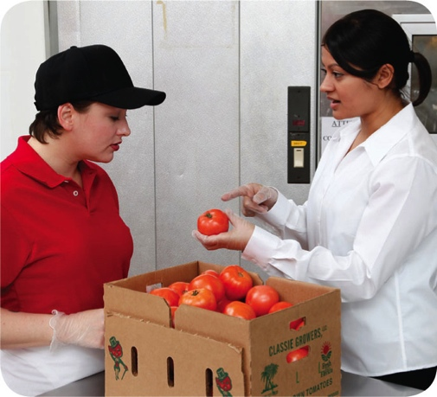
General Purchasing and Receiving Principles
Receiving principles:
  Make specific staff responsible for receiving
    Train them to follow food safety guidelines
    Provide them with the correct tools
  Have enough trained staff available to
  receive food promptly
    Inspect delivery trucks for signs of contamination
    Visually check food items and check temperatures
  Store items promptly after receiving
5-4
Notes:
Instructor Notes
Make specific staff responsible for receiving.
Provide staff with the tools they need, including purchase orders, thermometers, and scales. Then make sure enough trained staff is available to receive and inspect food items promptly. This starts by visually inspecting delivery trucks for signs of contamination. It continues with visually inspecting the food items and checking to make sure they have been received at the correct temperature.
Once inspected, food items must be stored as quickly as possible in the correct areas. This is especially true for refrigerated and frozen items.

Slide 39
Receiving and Inspecting
Key drop deliveries:
  Supplier is given after-hour access to the operation
  to make deliveries
  Deliveries must meet the following criteria
    Be inspected upon arrival at the operation
    Be from an approved source
    Have been placed in the correct storage location to
    maintain the required temperature
    Have been protected from contamination in storage
    Is NOT contaminated
    Is honestly presented
5-5
Notes:
Instructor Notes
Some foodservice operations receive food after-hours when they are closed for business. This is often referred to as a key drop delivery.
The supplier is given a key or other access to the operation to make the delivery. Products are then placed in coolers, freezers, and dry storage areas. The delivery must be inspected once you arrive at the operation and meet the criteria identified in the slide.

Slide 40
Receiving and Inspecting
Rejecting deliveries:
  Separate rejected items from accepted items
  Tell the delivery person what is wrong with the item
  Get a signed adjustment or credit slip before giving
  the rejected item to the delivery person
  Log the incident on the invoice or receiving document
5-6
Notes:
Instructor Notes
Occasionally, you may be able to recondition and use items that would have been rejected. For example, a shipment of cans with contaminated surfaces may be cleaned and sanitized, allowing them to be used. However, the same cans may not be reconditioned if the contamination was a result of damage to the cans.

Slide 41
Receiving and Inspecting
Recalls:
  Identify the recalled food items
  Remove the item from inventory, and place it in a secure and appropriate location
  Store the item separately from food, utensils, equipment, linens, and single-use items
  Label the item in a way that will prevent it from being placed back in inventory
  Inform staff not to use the product
  Refer to the vendor’s notification or recall notice to determine what to do with the item
5-7
Notes:
Instructor Notes
Food items you have received may sometimes be recalled by the manufacturer. This may happen when food contamination is confirmed or suspected. It can also occur when items have been mislabeled or misbranded. Often food is recalled when food allergens have not been identified on the label. Most vendors will notify you of the recall. However, you should also monitor recall notifications made by the FDA and the USDA. Follow the guidelines in the slide when notified of a recall.
Identify the recalled food items by matching information from the recall notice to the item. This may include the manufacturer’s ID, the time the item was manufactured, and the item’s use-by date.
Remove the item from inventory, and place it in a secure and appropriate location. That may be a cooler or dry-storage area.
The recalled item must be stored separately from food, utensils, equipment, linens, and single-use items.
Label the item in a way that will prevent it from being placed back in inventory. Some operations do this by including a Do Not Use and Do Not Discard label on recalled food items. Inform staff not to use the product.
Refer to the vendor’s notification or recall notice for what to do with the item. For example, you might be instructed to throw it out or return it to the vendor.

Slide 42
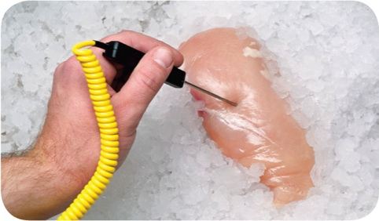
Receiving and Inspecting
Checking the temperature of meat, poultry,
and fish:
  Insert the thermometer stem or probe into the thickest part of the food (usually the center)
5-8

Slide 43
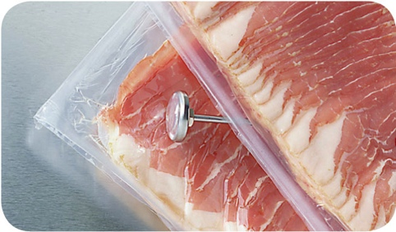
Receiving and Inspecting
Checking the temperature of ROP Food
(MAP, vacuum-packed, and sous vide food):
  Insert the thermometer stem or probe between
  two packages
  As an alternative, fold packaging around the thermometer stem or probe
5-9
Notes:
Instructor Notes
ROP stands for reduced-oxygen packaging. It includes MAP, vacuum-packed, and sous vide food.
It may be possible to check the temperature of bulk food by folding the packaging around the thermometer stem or probe. You must be careful not to puncture the packaging when using this method.

Slide 44
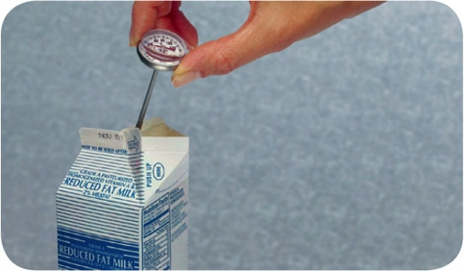
Receiving and Inspecting
Checking the temperature of other packaged food:
  Open the package and insert the thermometer stem or probe into the food
5-10
Notes:
Instructor Notes
When checking the temperature of food by this method, make sure the sensing area of the thermometer stem or probe is fully immersed in the food. It must not touch the package.

Slide 45
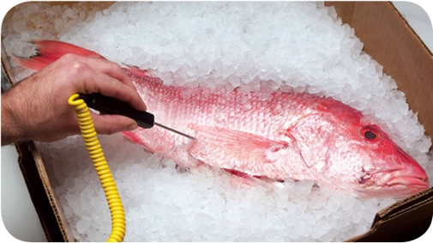
Receiving and Inspecting
Temperature criteria for deliveries:
  Cold TCS food: Receive at 41°F (5°C) or lower, unless otherwise specified
  Live shellfish: Receive oysters, mussels, clams, and scallops at an air temperature of 45°F (7°C) and an internal temperature no greater than
  50°F (10°C)
    Once received, the shellfish must be cooled to 41°F (5°C) or lower in four hours
  Shucked shellfish: Receive at 45°F (7°C)
  or lower
    Cool the shellfish to 41°F (5°C) or lower in
    four hours
5-11

Slide 46
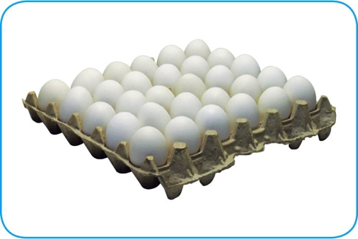
Receiving and Inspecting
Temperature criteria for deliveries:
  Shell eggs: Receive at an air temperature of 45°F (7°C) or lower
  Milk: Receive at 45°F (7°C) or lower
    Cool the milk to 41°F (5°C) or lower in four hours
  Hot TCS food: Receive at 135°F (57°C) or higher
  Frozen food: Receive frozen solid
5-12

Slide 47
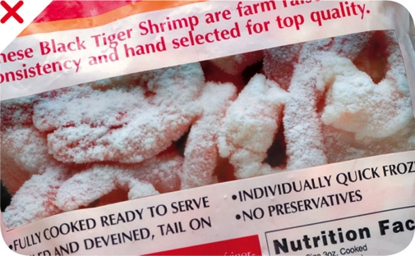
Receiving and Inspecting
Temperature criteria for deliveries:
  Reject frozen food if there is evidence of thawing and refreezing
    Fluids or water stains in case bottoms or
    on packaging
    Ice crystals or frozen liquids on the food
    or packaging
5-13
Notes:
Instructor Notes
Thawing and refreezing shows that the food was time-temperature abused.

Slide 48
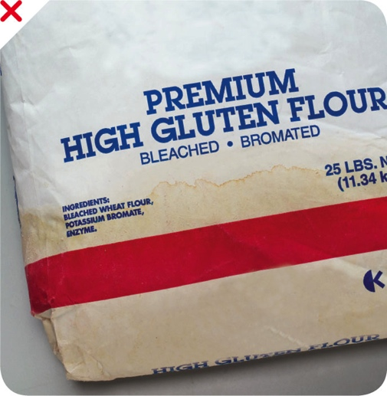
Receiving and Inspecting
Reject packaged items with:
  Tears, holes, or punctures in packaging; reject cans with swollen ends, rust, or dents
  Bloating or leaking (ROP food)
  Broken cartons or seals
  Dirty and discolored packaging
  Leaks, dampness, or water stains
  Signs of pests or pest damage
  Expired use-by/expiration dates
  Evidence of tampering
5-14
Notes:
Instructor Notes
Both food items and nonfood items such as single-use cups, utensils, and napkins, must be packaged correctly when you receive them. Items should be delivered in their original packaging with a manufacturer’s label. The packaging should be intact, clean, and protect food and food-contact surfaces from contamination. Reject food and nonfood items if packaging has any of the problems listed on the slide.

Slide 49
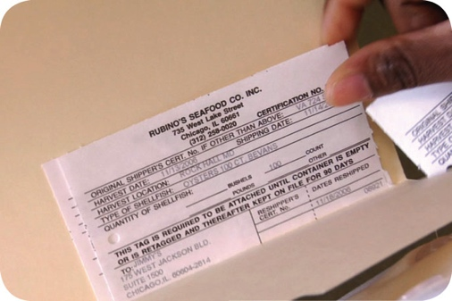
Receiving and Inspecting
Required documents:
  Shellfish must be received with shellstock identification tags
    Tags indicate when and where the shellfish were harvested
    Must be kept on file for 90 days from the date the last shellfish was used from its delivery container
5-15

Slide 50
Receiving and Inspecting
Required documents:
  Fish that will be eaten raw or partially cooked
    Documentation must show the fish was correctly frozen before being received
    Keep documents for 90 days from the sale of the fish
  Farm raised fish
    Must have documentation stating the fish was raised to FDA standards
    Keep documents for 90 days from the sale of the fish
5-16

Slide 51
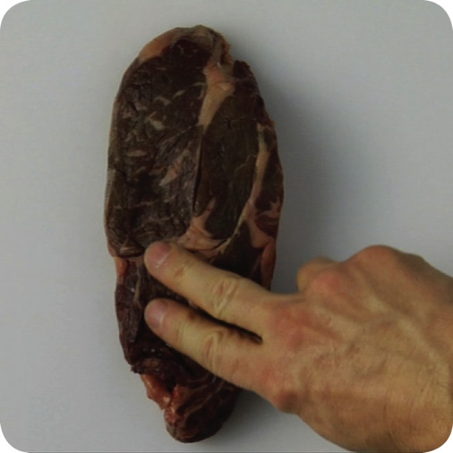
Receiving and Inspecting
Assessing food quality:
  Appearance: Reject food that is moldy or has an abnormal color
  Texture: Reject meat, fish, or poultry if
    It is slimy, sticky, or dry
    It has soft flesh that leaves an imprint when touched
  Odor: Reject food with an abnormal or unpleasant odor
5-17
Notes:
Instructor Notes
Poor food quality can be a sign that the food has been time-temperature abused and, therefore, may be unsafe.
In addition to the guidelines above, you should always reject any item that does not meet your company’s standards for quality.

Slide 52
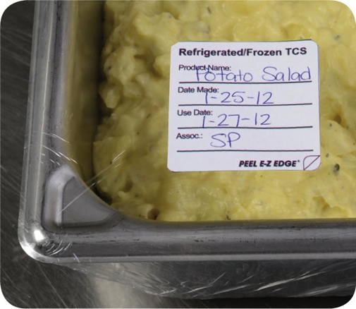
Storage
Labeling food for use on-site:
  All items not in their original containers must be labeled
  Food labels should include the common name of the food or a statement that clearly and accurately identifies it
  It is not necessary to label food if it clearly will not be mistaken for another item
5-18
Notes:
Instructor Notes
Labeling food is important for many reasons. Illnesses have occurred when unlabeled chemicals were mistaken for food such as flour, sugar, and baking powder. Customers have also suffered allergic reactions when food was unknowingly prepped with a food allergen that was not labeled.
It is not necessary to label food if it clearly will not be mistaken for another item. The food must be easily identified by sight.

Slide 53
Storage
Labeling food packaged on-site for retail sale:
  Common name of the food or a statement clearly identifying it
  Quantity of the food
  If the item contains two or more ingredients, list the ingredients
  in descending order by weight
  List of artificial colors and flavors in the food including
  chemical preservatives
  Name and place of business of the manufacturer, packer,
  or distributor
  Source of each major food allergen contained in the food
5-19
Notes:
Instructor Notes
Food packaged in the operation that is being sold to customers for use at home must be labeled. The label must include the information on the slide.
Naming the source of each major food allergen contained in the food is not necessary if the source is already part of the common name of the ingredient.

Slide 54
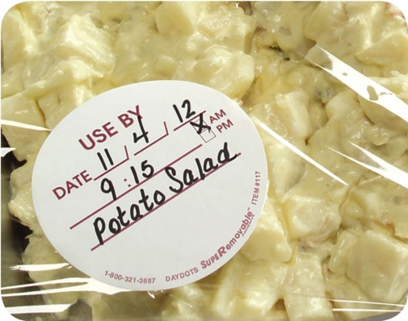
Storage
Date marking:
  Ready-to-eat TCS food must be marked if held for longer than 24 hours
    Date mark must indicate when the food must be sold, eaten, or thrown out
5-20
Notes:
Instructor Notes
Refrigeration slows the growth of most bacteria. Some types, such as Listeria monocytogenes, grow well at refrigeration temperatures. When food is refrigerated for long periods of time, these bacteria can grow enough to cause illness. For this reason, ready-to-eat TCS food must be marked if held for longer than 24 hours. It must indicate when the food must be sold, eaten, or thrown out.

Slide 55
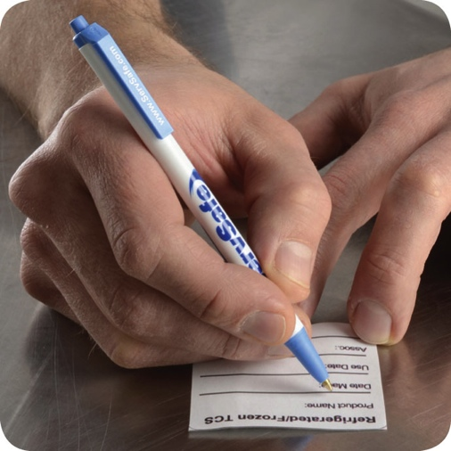
Storage
Date marking:
  Ready-to-eat TCS food can be stored for only seven days if it is held at 41°F (5°C)
  or lower
    The count begins on the day that the food was prepared or a commercial container
    was opened
    For example, potato salad prepared and stored on October 1 would have a discard date of October 7 on the label
    Some operations write the day or date the food was prepared on the label; others write the use-by day or date on the label
5-21

Slide 56
Storage
Date marking:
  If:
  A commercially processed food has a use-by date that is less
  than seven days from the date the container was opened
  Then:
  The container should be marked with this use-by date
  as long as the date is based on food safety
5-22
Notes:
Instructor Notes
Operations have a variety of systems for date marking. Some write the day or date the food was prepped on the label. Others write the use-by day or date on the label.

Slide 57
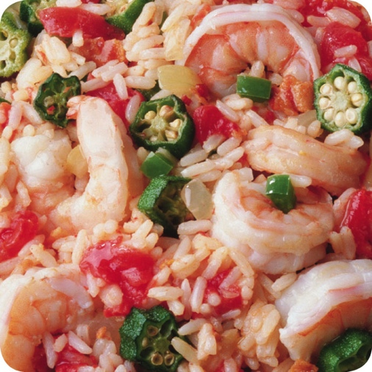
Storage
Date marking:
  When combining food in a dish with different
  use-by dates, the discard date of the dish should be based on the earliest prepared food
  Consider a shrimp and sausage jambalaya prepared on December 4
    The shrimp has a use-by date of December 8
    The sausage has a use-by date of December 10
    The use-by date of the jambalaya is December 8
5-23

Slide 58
Storage
Temperatures:
  Store TCS food at an internal temperature
  of 41°F (5°C) or lower or 135°F (57°C)
  or higher
  Store frozen food at temperatures that keep it frozen
  Make sure storage units have at least one air temperature measuring device; it must be accurate to +/- 3°F or +/- 1.5°C
  Place the device in the warmest part of refrigerated units, and the coldest part of hot-holding units
5-24
Notes:
Instructor Notes
Pathogens can grow when food is not stored at the correct temperature. Follow the guidelines on the slide to keep food safe.

Slide 59
Storage
Temperatures:
  Do NOT overload coolers or freezers
    Prevents airflow
    Makes unit work harder
  Frequent opening of the cooler lets warm air inside, which can affect food safety
  Use open shelving
    Lining shelving restricts circulation
  Monitor food temperatures regularly
    Randomly sample food temperatures
5-25
Notes:
Instructor Notes
Do not overload coolers or freezers. Storing too many food items prevents good airflow and makes the units work harder to stay cold.
Be aware that frequent opening of the cooler lets warm air inside, which can affect food safety.
Use open shelving. Do not line shelves with aluminum foil, sheet pans, or paper. This restricts circulation of cold air in the unit.
Monitor food temperatures regularly. Randomly sample the temperature of stored food to verify that the cooler is working.

Slide 60
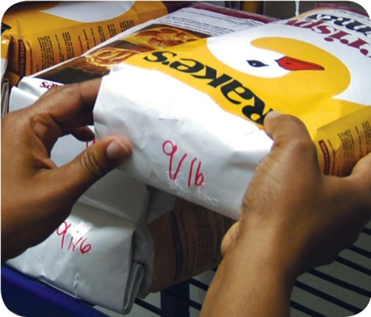
Storage
Rotate food to use the oldest inventory first:
  One way to rotate products is to follow FIFO
    Identify the food item’s use-by or expiration date
    Store items with the earliest use-by or expiration dates in front of items with later dates
    Once shelved, use those items stored in front first
    Throw out food that has passed its manufacturer’s use-by or expiration date
5-26
Notes:
Instructor Notes
Food must be rotated in storage to maintain quality and limit the growth of pathogens. Food items must be rotated so that those with the earliest use-by or expiration dates are used before items with later dates.
Many operations use the first-in, first-out (FIFO) method to rotate their refrigerated, frozen, and dry food during storage. Here is one way to use the FIFO method.

Slide 61
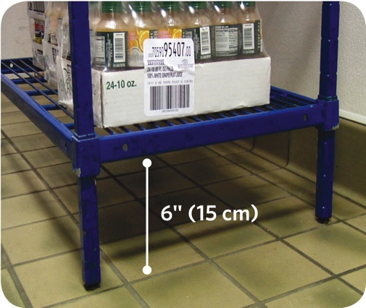
Storage
Preventing cross-contamination:
  Store all items in designated storage areas
    Store items away from walls and at least
    six inches (15 centimeters) off the floor
    Store single-use items (e.g., sleeve of
    single-use cups, single-use gloves) in
    original packaging
5-27

Slide 62
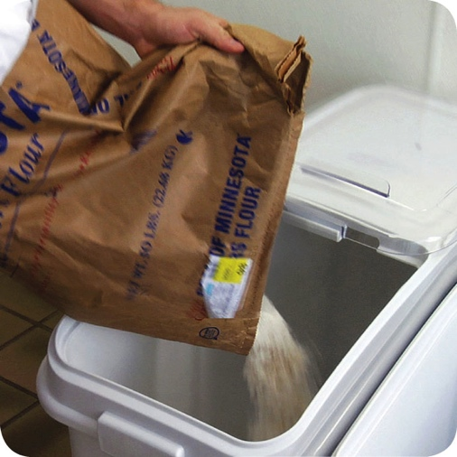
Storage
Preventing cross-contamination:
  Store food in containers intended for food
  Use containers that are durable, leak proof, and able to be sealed or covered
  NEVER use empty food containers to store chemicals; NEVER put food in empty chemical containers
5-28

Slide 63

Storage
Preventing cross-contamination:
  Keep all storage areas clean and dry
  Clean up spills and leaks immediately
  Clean dollies, carts, transporters, and trays often
  Store food in containers that have been cleaned and sanitized
  Store dirty linens in clean, nonabsorbent containers or washable laundry bags
5-29
Notes:
Instructor Notes
Keep all storage areas clean and dry. Clean floors, walls, and shelving in coolers, freezers, dry-storage areas, and heated holding cabinets on a regular basis.
Clean up spills and leaks promptly to keep them from contaminating other food.
• Store dirty linens away from food.

Slide 64

Storage
Preventing cross-contamination:
  Wrap or cover food
  Store raw meat, poultry, and seafood separately from ready-to-eat food
    If this is not possible, store ready-to-eat food above raw meat, poultry, and seafood
    This will prevent juices from raw food from dripping onto ready-to-eat food
5-30
Notes:
Instructor Notes

Slide 65

Storage
Preventing cross-contamination:
  Store food items in the following
  top-to-bottom order
    Ready-to-eat food
    Seafood
    Whole cuts of beef and pork
    Ground meat and ground fish
    Whole and ground poultry
  This storage order is based on the minimum internal cooking temperature of each food
5-31
Notes:
Instructor Notes
Raw meat, poultry, and seafood can be stored with or above ready-to-eat food in a freezer if all of the items have been commercially processed and packaged.
Frozen food that is being thawed in coolers must also be stored below ready-to-eat food.
As an exception, ground meat and ground fish can be stored above whole cuts of beef and pork. To do this, make sure the packaging keeps out pathogens and chemicals. It also must not leak.

Slide 66
Storage
Food should be stored in a clean, dry location away from dust and other contaminants:
  To prevent contamination, NEVER store food in these areas
    Locker rooms or dressing rooms
    Restrooms or garbage rooms
    Mechanical rooms
    Under unshielded sewer lines or leaking water lines
    Under stairwells
5-32

