Slide 2
Providing Safe Food
Objectives:
Recognize the importance of food safety
Understand how food becomes unsafe
Identify TCS food
Recognize the risk factors for foodborne illness
Understand important prevention measures for keeping food safe
1-2
Notes:
Instructor Notes
Discuss the topic objectives with the class.

Slide 3
Challenges to Food Safety
A foodborne illness is a disease transmitted to people through food.
An illness is considered an outbreak when:
Two or more people have the same symptoms after eating the same food
An investigation is conducted by state and local regulatory authorities
The outbreak is confirmed by laboratory analysis
1-3

Slide 4
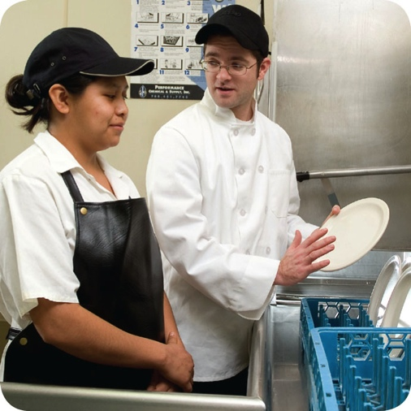
Challenges to Food Safety
Challenges include:
Time and money
Language and culture
Literacy and education
Pathogens
Unapproved suppliers
High-risk customers
Staff turnover
1-4
Notes:
Instructor Notes
Pressure to work quickly can make it hard to take the time to follow food safety practices.
Your staff may speak a different language than you do, which can make it difficult to communicate. Cultural differences can also influence how food handlers view food safety.
Staff often have different levels of education, making it more challenging to teach them food safety.
Illness-causing microorganisms are more frequently found on food that once was considered safe.
Food that is received from suppliers that are not practicing food safety can cause a foodborne-illness outbreak.
The number of customers at high risk for getting a foodborne illness is increasing. An example of this is the growing elderly population.
Training new staff leaves less time for food safety training.
The ServSafe program will provide the tools needed to overcome the challenges in managing a good food safety program.

Slide 5
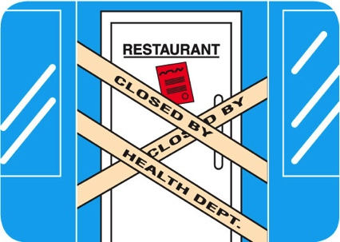
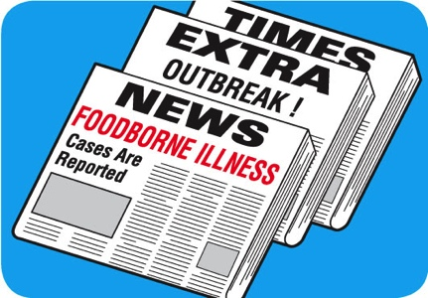
Costs of Foodborne Illness
Costs of a foodborne illness to an operation:
Loss of customers and sales
Loss of reputation
Negative media exposure
Lowered staff morale
1-5
Notes:
Instructor Notes
National Restaurant Association figures show that one foodborne-illness outbreak can cost an operation thousands of dollars and even result in closure.
Most important, victims of foodborne illness may experience lost work, medical costs, long-term disability, and even death.

Slide 6
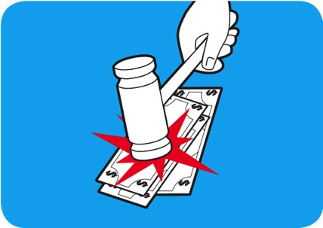
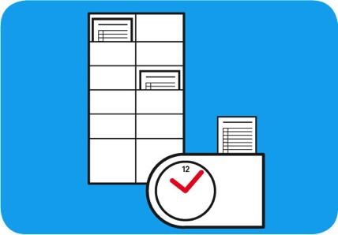
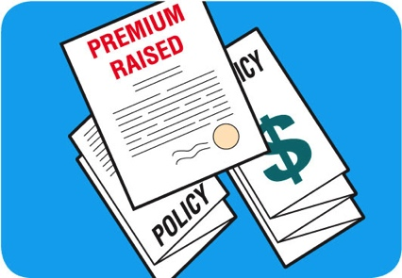
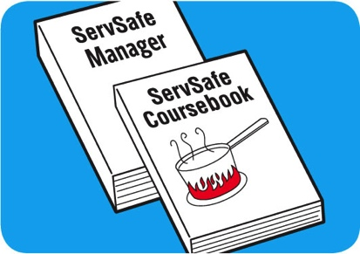
Costs of Foodborne Illness
Costs of a foodborne illness to an operation:
Lawsuits and legal fees
Staff missing work
Increased insurance premiums
Staff retraining
1-6
Notes:
Instructor Notes
National Restaurant Association figures show that one foodborne-illness outbreak can cost an operation thousands of dollars and even result in closure.
Most important, victims of foodborne illness may experience lost work, medical costs, long-term disability, and even death.

Slide 7
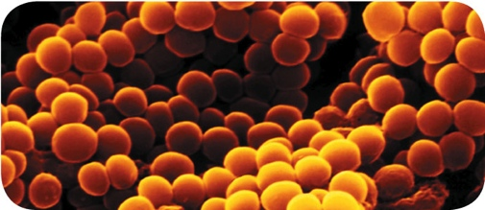
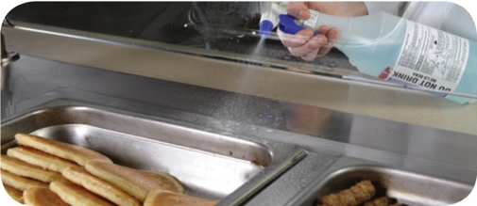
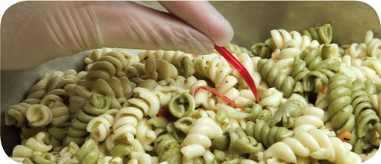
How Foodborne Illnesses Occur
Unsafe food is the result of contamination:
Biological
Chemical
Physical
1-7
Notes:
Instructor Notes
Unsafe food is usually the result of contamination, which is the presence of harmful substances in the food.
Contaminants can come from pathogens, chemicals, or physical objects. They might also come from certain unsafe practices in your operation.
Each of the contaminants listed above is a danger to food safety. But biological contaminants are responsible for most foodborne illness.

Slide 8
Contaminants
Biological contaminants:
Bacteria
Viruses
Parasites
Fungi
1-8
Notes:
Instructor Notes
Pathogens are the greatest threat to food safety. They include certain viruses, parasites, fungi, and bacteria. Some plants, mushrooms, and seafood that carry harmful toxins (poisons) are also included in this group.

Slide 9
Contaminants
Chemical contaminants:
Cleaners
Sanitizers
Polishes
1-9
Notes:
Instructor Notes
Foodservice chemicals can contaminate food if they are used incorrectly.

Slide 10
Contaminants
Physical hazards:
Metal shavings
Staples
Bandages
Glass
Dirt
Natural objects (e.g., fish bones in a fillet)
1-10
Notes:
Instructor Notes

Slide 11
How Food Becomes Unsafe
Five risk factors for foodborne illness:
Purchasing food from unsafe sources
Failing to cook food correctly
Holding food at incorrect temperatures
Using contaminated equipment
Practicing poor personal hygiene
1-11
Notes:
Instructor Notes
If food is not handled correctly, it can become unsafe. These are the five most common food-handling mistakes, or risk factors, that can cause foodborne illness.

Slide 12
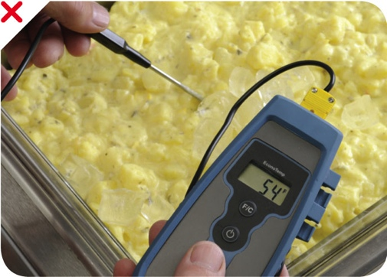
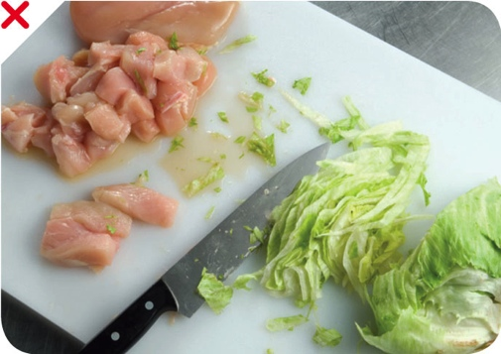
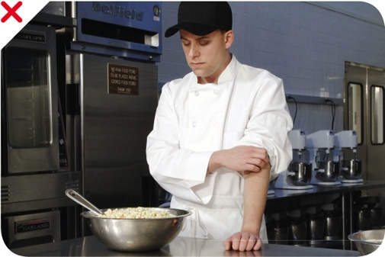
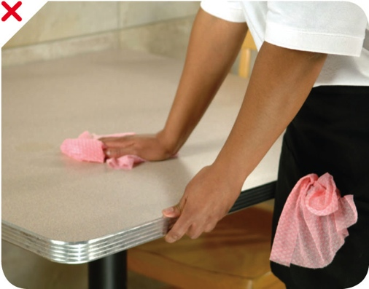
How Food Becomes Unsafe
Time-temperature abuse
Cross-contamination
Poor personal hygiene
Poor cleaning and sanitizing
1-12
Notes:
Instructor Notes
Except for purchasing food from unsafe sources, each risk factor for foodborne illness is related to four main factors: time-temperature abuse, cross-contamination, poor personal hygiene, and poor cleaning and sanitizing.

Slide 13
How Food Becomes Unsafe
Time-temperature abuse:
When food has stayed too long at temperatures good for pathogen growth
1-13

Slide 14
How Food Becomes Unsafe
Food has been time-temperature abused when:
It has not been held or stored at correct temperatures
It is not cooked or reheated enough to kill pathogens
It is not cooled correctly
Pg 1.5 SSF 6e
Pg 1.5 SSF 6e
Pg 1.5 SSF 6e
1-14

Slide 15
How Food Becomes Unsafe
Cross-contamination:
When pathogens are transferred from one surface or food to another
Pg 1.5 SSF 6e
1-15

Slide 16
How Food Becomes Unsafe
Cross-contamination can cause a foodborne illness when:
Contaminated ingredients are added to food that receives no further cooking
Ready-to-eat food touches contaminated surfaces
A food handler touches contaminated food and then touches ready-to-eat food
Contaminated cleaning cloths touch food-contact surfaces
Pg 1.5 SSF 6e
1-16

Slide 17
How Food Becomes Unsafe
Poor personal hygiene can cause a foodborne illness when food handlers:
Fail to wash their hands correctly after using the restroom
Cough or sneeze on food
Touch or scratch wounds and then touch food
Work while sick
Pg 1.5 SSF 6e
1-17

Slide 18
How Food Becomes Unsafe
Poor cleaning and sanitizing:
Equipment and utensils are not washed, rinsed, and sanitized between uses
Food-contact surfaces are wiped clean instead of being washed, rinsed, and sanitized
Wiping cloths are not stored in a sanitizer solution between uses
Sanitizer solution was not prepared correctly
Pg 1.5 SSF 6e
1-18

Slide 19
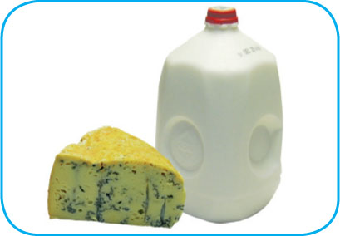
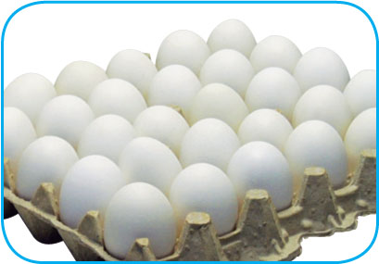
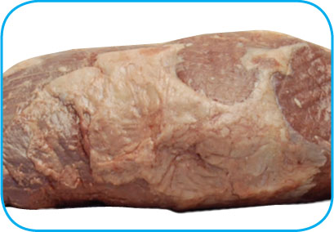
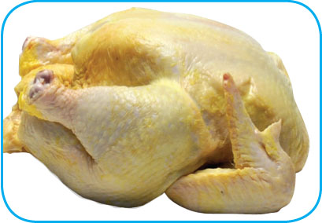
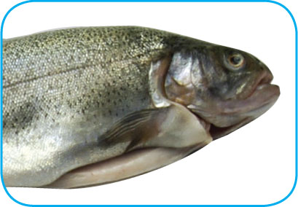
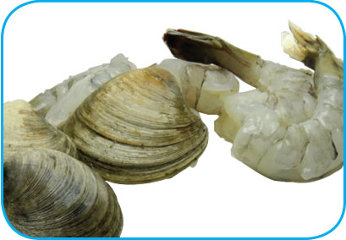
Food Most Likely to Become Unsafe
TCS food:
1-19
Notes:
Instructor Notes
The list of TCS food includes the following:
Milk and dairy products
Shell eggs (except those treated to eliminate Salmonella spp.)
Meat: beef, pork, and lamb
Poultry
Fish
Shellfish and crustaceans

Slide 20
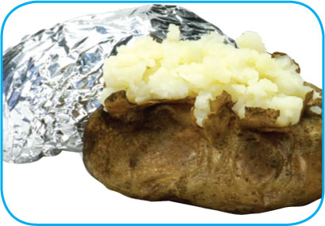
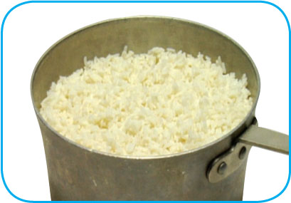
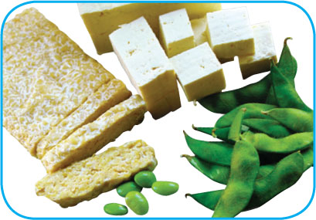
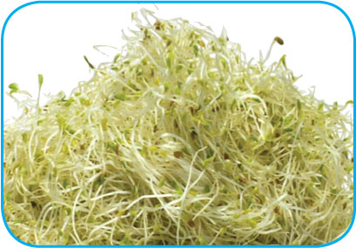
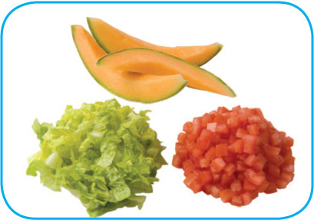
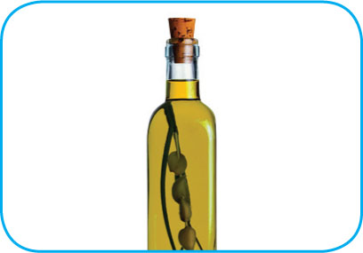
Food Most Likely to Become Unsafe
TCS food:
1-20
Notes:
Instructor Notes
The list of TCS food includes the following:
Baked potatoes
Heat-treated plant food, such as cooked rice, beans, and vegetables
Tofu or other soy protein; synthetic ingredients, such as textured soy protein in meat alternatives
Sprouts and sprout seeds
Sliced melons; cut tomatoes; cut leafy greens
Untreated garlic-and-oil mixtures

Slide 21
Ready-to-Eat Food
Ready-to-eat food is food that can be eaten without further:
Preparation
Washing
Cooking
Ready-to-eat food includes:
Cooked food
Washed fruit and vegetables
Deli meat
Bakery items
Sugar, spices, and seasonings
1-21
Notes:
Instructor Notes
Like TCS food, ready-to-eat food also needs careful handling to prevent contamination.

Slide 22
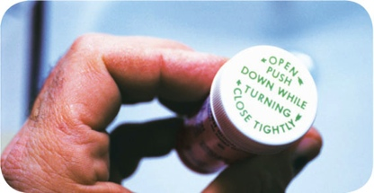
Populations at High Risk for Foodborne Illnesses
These people have a higher risk of getting a foodborne illness:
Elderly people
Preschool-age children
People with compromised immune systems
1-22
Notes:
Instructor Notes
Elderly people are at high risk because their immune systems have weakened with age.
Very young children are at high risk because they have not built up strong immune systems.
People with compromised immune systems include:
People with cancer or on chemotherapy
People with HIV/AIDS
Transplant recipients
People taking certain medications

Slide 23
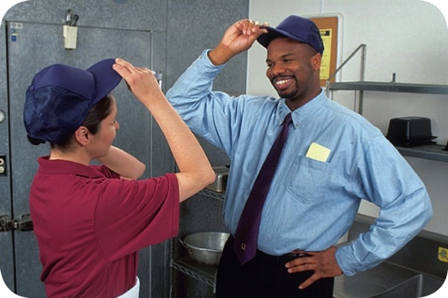
Keeping Food Safe
Focus on these measures:
Controlling time and temperature
Preventing cross-contamination
Practicing personal hygiene
Purchasing from approved, reputable suppliers
Cleaning and sanitizing
1-23
Notes:
Instructor Notes
Set up standard operating procedures that focus on these areas. The ServSafe program will show you how to design these procedures.

Slide 24
Keeping Food Safe
Training and monitoring:
Train staff to follow food safety procedures
Provide initial and ongoing training
Provide all staff with general food safety knowledge
Provide job specific food safety training
Retrain staff regularly
Monitor staff to make sure they are following procedures
Document training
1-24
Notes:
Instructor Notes
Managers must set up standard operating procedures that focus on the measures listed on the slide. Then they must train their staff on these procedures and monitor them to make sure the procedures are followed.

Slide 25
Keeping Food Safe
Government agencies:
The Food and Drug Administration (FDA)
U.S. Department of Agriculture (USDA)
Centers for Disease Control and Prevention (CDC)
U.S. Public Health Service (PHS)
State and local regulatory authorities
1-25
Notes:
Instructor Notes
The Food and Drug Administration (FDA) inspects all food except meat, poultry, and eggs. The agency also regulates food transported across state lines. In addition, the agency issues the FDA Food Code, which provides recommendations for food safety regulations.
The U.S. Department of Agriculture (USDA) regulates and inspects meat, poultry, and eggs. It also regulates food that crosses state boundaries or involves more than one state.
Agencies such as the Centers for Disease Control and Prevention (CDC) and the U. S. Public Health Service (PHS) conduct research into the causes of foodborne-illness outbreaks.
State and local regulatory authorities write or adopt code that regulates retail and foodservice operations.

Slide 27
You Can Prevent Contamination
Objectives:
Biological, chemical, and physical contaminants and how to prevent them
How to prevent the deliberate contamination of food
How to respond to a foodborne-illness outbreak
Common food allergens and how to prevent reactions to them
2-2
Notes:
Instructor Notes
Discuss the topic objectives with the class.

Slide 28
How Contamination Happens
Contaminants come from a variety of places:
Animals we use for food
Air, contaminated water, and dirt
People
Deliberately
Accidentally
2-3
Notes:
Instructor Notes
Contamination comes from a variety of places.
Contaminants can cause foodborne illness or result in physical injury.
Contaminants are found in the animals we use for food, the air, water, dirt; and they occur naturally in food, such as bones in fish.
Food can be contaminated on purpose.
Most food is contaminated accidently.
Examples of accidental contamination include: food handlers who don’t wash their hands after using the restroom, and then contaminate food and surfaces with feces from their fingers; and food handlers who pass contaminants through illness.

Slide 29
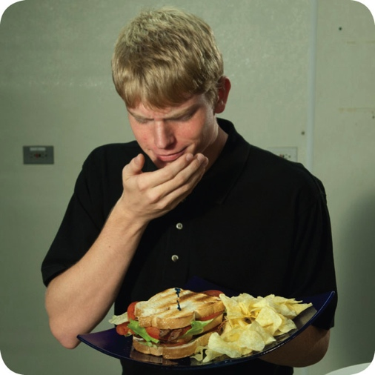
How Contamination Happens
People can contaminate food when:
They don’t wash their hands after using the restroom
They are in contact with a person who is sick
They sneeze or vomit onto food or food-contact surfaces
They touch dirty food-contact surfaces and equipment and then touch food
2-4
Notes:
Instructor Notes
Food handlers who don’t wash their hands after using the restroom may contaminate food and surfaces with feces from their fingers. Once the food that the food handler touched is eaten, a foodborne illness may result. This is called the fecal-oral route of contamination.

Slide 30
Biological Contamination
Microorganism:
Small, living organism that can be seen only with a microscope
Pathogen:
Harmful microorganism
Makes people sick when eaten or produces toxins that cause illness
Toxin:
Poison
2-5
Notes:
Instructor Notes
Biological contamination occurs when harmful microorganisms, referred to as pathogens, contaminate food.

Slide 31
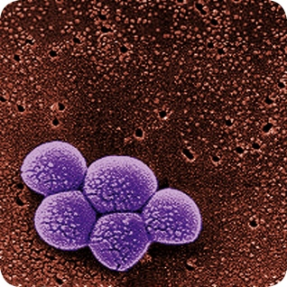
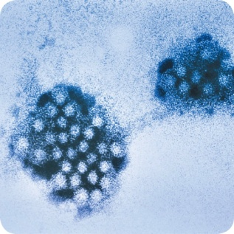
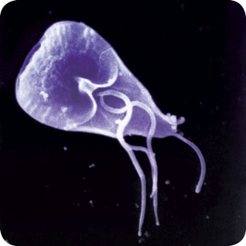
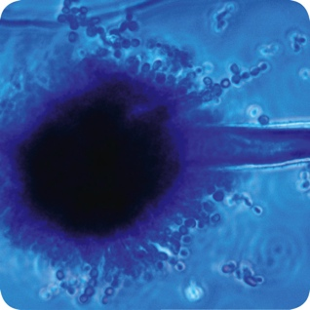
Biological Contamination
Four types of pathogens can contaminate food and cause foodborne illness:
Bacteria
Viruses
Parasites
Fungi
2-6
Notes:
Instructor Notes
Each type of pathogen will be discussed in more detail throughout the presentation.

Slide 32
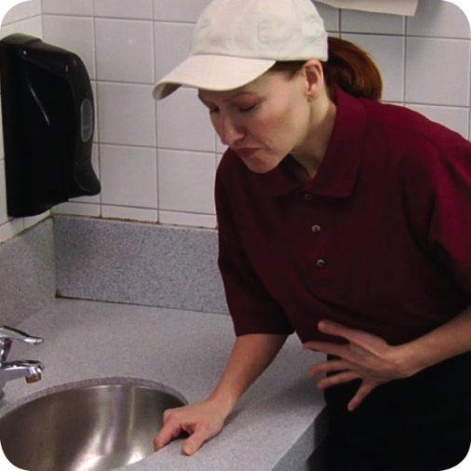
Biological Contamination
Common symptoms of foodborne illness:
Diarrhea
Vomiting
Fever
Nausea
Abdominal cramps
Jaundice (yellowing of skin and eyes)
Onset times:
Depend on the type of foodborne illness
Can range from 30 minutes to six weeks
2-7
Notes:
Instructor Notes
The symptoms of a foodborne illness vary depending on which illness a person has. But most victims of foodborne illness share some common symptoms.
Not every person who is sick from a foodborne illness will have all of these symptoms. Nor are the symptoms of a foodborne illness limited to this list.
How quickly foodborne-illness symptoms appear in a person is known as the onset time of the illness. Onset times depend on the type of foodborne illness a person has. They can range from 30 minutes to as long as six weeks. How severe the illness is can also vary, from mild diarrhea to death.

Slide 33
Bacteria: Basic Characteristics
Location:
Found almost everywhere
Detection:
Cannot be seen, smelled, or tasted
Growth:
Will grow rapidly if FAT TOM conditions are correct
Prevention:
Control time and temperature
2-8
Notes:
Instructor Notes
Bacteria live in our bodies. Some types of bacteria keep us healthy, while others cause illness.
The most important way to prevent bacteria from causing foodborne illness is to control time and temperature.

Slide 34
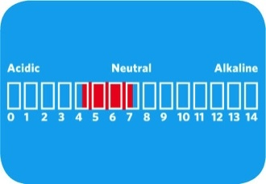
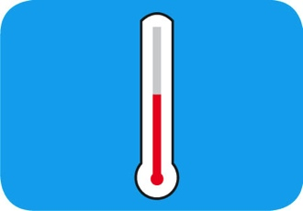
What Bacteria Need to Grow
F
Food
A
Acidity
T
Temperature
T
Time
O
Oxygen
M
Moisture
2-9
Notes:
Instructor Notes
Bacteria need six conditions to grow. You can remember these conditions by thinking of the words FAT TOM.

Slide 35
What Bacteria Need to Grow
Food:
Most bacteria need nutrients to survive
TCS food supports the growth of bacteria better than other types of food
F
Food
2-10

Slide 36
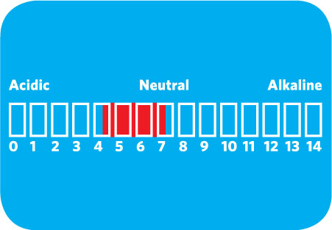
What Bacteria Need to Grow
Acidity:
Bacteria grow best in food that contains little or no acid
A
Acidity
2-11
Notes:
Instructor Notes
The pH scale ranges from 0 to 14.0.
A value of 0 is highly acidic, while a value of 14 is highly alkaline.
A pH of 7 is neutral.
Bacteria grow best in food that is neutral to slightly acidic.

Slide 37
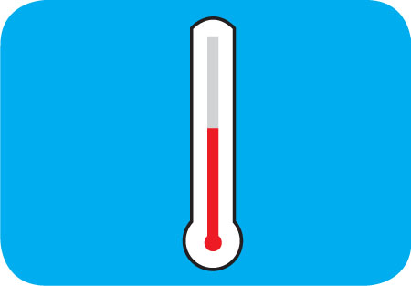
What Bacteria Need to Grow
Temperature:
Bacteria grow rapidly between 41˚F and 135˚F (5˚C and 57˚C)
This range is known as the temperature danger zone
Bacteria growth is limited when food is held above or below the temperature danger zone
T
Temperature
2-12
Notes:
Instructor Notes
Bacteria grow even more rapidly from 70° F to 125° F (21°C to 52°C).

Slide 38
What Bacteria Need to Grow
Time:
Bacteria need time to grow
The more time bacteria spend in the temperature danger zone, the greater chance they have to grow to unsafe levels
T
Time
2-13
Notes:
Instructor Notes

Slide 39
What Bacteria Need to Grow
Oxygen:
Some bacteria need oxygen to grow, while others grow when oxygen isn’t there
O
Oxygen
2-14

Slide 40
What Bacteria Need to Grow
Moisture:
Bacteria grow well in food with high levels of moisture
aw = water activity; the amount of moisture available in food for bacterial growth
aw scale ranges from 0.0 to 1.0
Water has a water activity of 1.0
M
Moisture
2-15
Notes:
Instructor Notes
The amount of moisture available in food is called water activity (aw). The aw scale ranges from 0.0 to 1.0.
The higher the value, the more available moisture in the food.

Slide 41
Control FAT TOM
The conditions you can control:
Temperature
Keep TCS food out of the temperature danger zone
Time
Limit how long TCS food is in the temperature danger zone
2-16
Notes:
Instructor Notes
Temperature and time are the two important conditions for growth that can be controlled in the operation.

Slide 42
Major Bacteria That Cause Foodborne Illness
The FDA has identified three types of bacteria that cause severe illness and are highly contagious:
Salmonella Typhi
Shigella spp.
Enterohemorrhagic and shiga toxin-producing Escherichia coli
2-17
Notes:
Instructor Notes
Food handlers with illnesses from these bacteria can NEVER work in a foodservice operation while they are sick.
These three bacteria are included in the FDA’s “Big Five” pathogens.

Slide 43
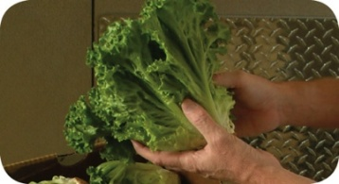
Major Bacteria That Cause Foodborne Illness
Bacteria: Salmonella Typhi (SAL-me-NEL-uh TI-fee)
Source: People
Food Linked with the Bacteria | Prevention Measures
Ready-to-eat food Beverages | Exclude food handlers diagnosed with an illness caused by Salmonella Typhi from the operation
 | Wash hands
 | Cook food to minimum internal temperatures
2-18
Notes:
Instructor Notes
Salmonella Typhi lives only in humans.
People with typhoid fever carry the bacteria in their bloodstream and intestinal tract.
Eating only a small amount of these bacteria can make a person sick.
The severity of symptoms depends on the health of the person and the amount of bacteria eaten. The bacteria are often in a person’s feces for weeks after symptoms have ended.

Slide 44
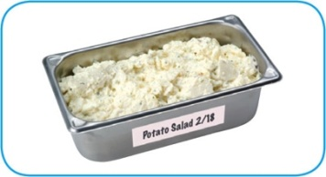
Major Bacteria That Cause Foodborne Illness
Bacteria: Shigella spp. (shi-GEL-uh)
Source: Human feces
Food Linked with the Bacteria | Prevention Measures
Food easily contaminated by hands, such as salads containing TCS food (potato, tuna, shrimp, macaroni, chicken) | Exclude food handlers diagnosed with an illness caused by Shigella spp. from the operation Exclude food handlers who have diarrhea from the operation
Food that has made contact with contaminated water, such as produce | Wash hands
 | Control flies inside and outside the operation
2-19
Notes:
Instructor Notes
Shigella spp. is found in the feces of humans with the illness.
Most illnesses occur when people eat or drink contaminated food or water.
Flies can also transfer the bacteria from feces to food.
Eating only a small amount of these bacteria can make a person sick.
High levels of the bacteria are often in a person’s feces for weeks after symptoms have ended.

Slide 45
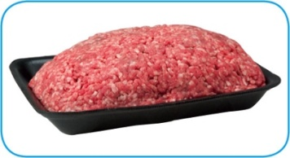
Major Bacteria That Cause Foodborne Illness
Bacteria: Enterohemorrhagic and shiga toxin-producing
Escherichia coli (ess-chur-EE-kee-UH-KO-LI)
Source: Intestines of cattle; infected people
Food Linked with the Bacteria | Prevention Measures
Ground beef (raw and undercooked) Contaminated produce | Exclude food handlers who have diarrhea or have been diagnosed with a disease from the bacteria Cook food, especially ground beef, to minimum internal temperatures
 | Purchase produce from approved, reputable suppliers
 | Prevent cross-contamination between raw meat and ready-to-eat food
2-20
Notes:
Instructor Notes
Enterohemorrhagic and shiga toxin-producing E. coli can be found in the intestines of cattle.
It is also found in infected people.
The bacteria can contaminate meat during slaughtering.
Eating only a small amount of the bacteria can make a person sick.
Once eaten, it produces toxins in the intestines, which cause the illness.
The bacteria are often in a person’s feces for weeks after symptoms have ended.

Slide 46
Viruses: Basic Characteristics
Location:
Carried by human beings and animals
Require a living host to grow
Do not grow in food
Can be transferred through food and remain infectious in food
Sources:
Food, water, or any contaminated surface
Typically occur through fecal-oral routes
2-21
Notes:
Instructor Notes
Viruses are the leading cause of foodborne illness.

Slide 47
Viruses: Basic Characteristics
Destruction:
Not destroyed by normal cooking temperatures
Good personal hygiene must be practiced when handling food and food-contact surfaces
Quick removal and cleanup of vomit is important
2-22

Slide 48
Major Viruses that Cause Foodborne Illnesses
The FDA has identified two viruses that are highly contagious and can cause severe illness:
Hepatitis A
Norovirus
Food handlers diagnosed with an illness from hepatitis A or Norovirus must not work in an operation while they are sick.
2-23
Notes:
Instructor Notes
These two viruses are included in the FDA’s “Big Five” pathogens.

Slide 49
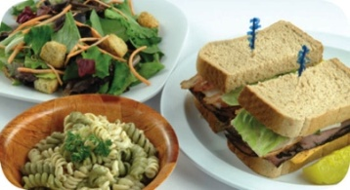
Major Viruses That Cause Foodborne Illness
Virus: Hepatitis A (HEP-a-TI-tiss)
Source: Human feces
Food Linked with the Virus | Prevention Measures
Ready-to-eat food Shellfish from contaminated water | Exclude staff who have been diagnosed with hepatitis A from the operation
 | Exclude staff who have jaundice from the operation
 | Wash hands
 | Avoid bare-hand contact with ready-to-eat food
 | Purchase shellfish from approved, reputable suppliers
2-24
Notes:
Instructor Notes
Hepatitis A is mainly found in the feces of people infected with it.
The virus can contaminate water and many types of food.
It is commonly linked with ready-to-eat food. However, it has also been linked with shellfish from contaminated water.
The virus is often transferred to food when infected food handlers touch food or equipment with fingers that have feces on them.
Eating only a small amount of the virus can make a person sick.
An infected person may not show symptoms for weeks but can be very infectious.
Cooking does not destroy hepatitis A.

Slide 50
Major Viruses That Cause Foodborne Illness
Virus: Norovirus (NOR-o-VI-rus)
Source: Human feces
Food Linked with the Virus | Prevention Measures
Ready-to-eat food Shellfish from contaminated water | Exclude staff who have been diagnosed with Norovirus from the operation
 | Exclude staff who have diarrhea and vomiting from the operation
 | Wash hands
 | Avoid bare-hand contact with ready-to-eat food
 | Purchase shellfish from approved, reputable suppliers
2-25
Notes:
Instructor Notes
Like hepatitis A, Norovirus is commonly linked with ready-to-eat food.
It has also been linked with contaminated water.
Norovirus is often transferred to food when infected food handlers touch food or equipment with fingers that have feces on them.
Eating only a small amount of Norovirus can make a person sick. It is also very contagious.
People become contagious within a few hours after eating it.
The virus is often in a person’s feces for days after symptoms have ended.

Slide 51
Parasites: Basic characteristics
Location:
Require a host to live and reproduce
Source:
Seafood, wild game, and food processed with contaminated water, such as produce
2-26

Slide 52
Parasites: Basic characteristics
Prevention:
Purchase food from approved, reputable suppliers
Cook food to required minimum internal temperatures
Fish that will be served raw or undercooked must be frozen correctly by the manufacturer
2-27
Notes:
Instructor Notes
The most important way to prevent foodborne illnesses from parasites is to purchase food from approved, reputable suppliers.
Cooking food to required minimum internal temperatures is also important.
Make sure that fish that will be served raw or undercooked has been correctly frozen by the manufacturer.

Slide 53
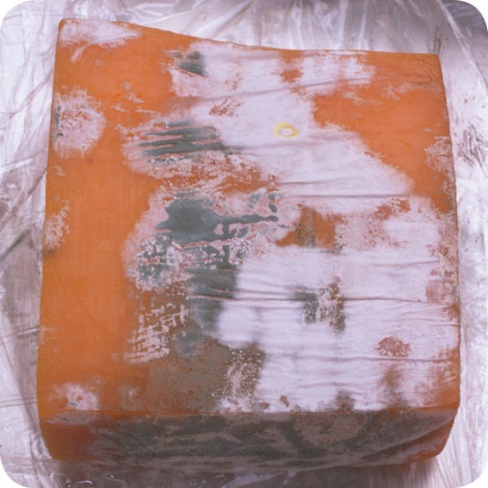
Fungi: Basic Characteristics
Yeasts, molds, and mushrooms:
Some molds and mushrooms produce toxins
Throw out moldy food unless mold is a natural part of the food
Purchase mushrooms from approved, reputable suppliers
2-28
Notes:
Instructor Notes
Fungi include yeasts, molds, and mushrooms.

Slide 54
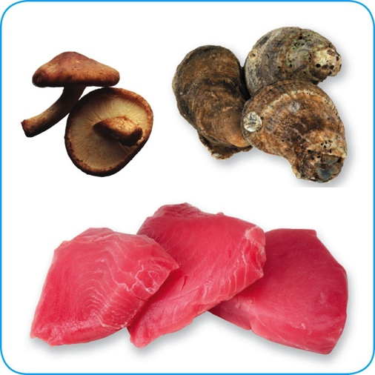
Biological Toxins
Origin:
Naturally occur in certain plants, mushrooms, and seafood
Seafood toxins:
Produced by pathogens found on certain fish
Tuna, bonito, mahimahi
Histamine produced when fish is time-temperature abused
Occur in certain fish that eat smaller fish that have consumed the toxin
Barracuda, snapper, grouper, amberjack
Ciguatera toxin is an example
2-29
Notes:
Instructor Notes
Some toxins are naturally associated with certain plants, mushrooms, and seafood. Toxins are a natural part of some fish.
Other toxins, such as histamine, are made by pathogens on the fish when it is time-temperature abused. This can occur in tuna, bonito, mackerel, and mahimahi.
Some fish become contaminated when they eat smaller fish that have eaten a toxin. One of these toxins is the ciguatera toxin. It can be found in barracuda, snapper, grouper, and amberjack. Shellfish, such as oysters, can be contaminated when they eat marine algae that have a toxin.

Slide 55
Biological Toxins
Illness:
Symptoms and onset times vary with illness
People will experience illness within minutes
General symptoms:
Diarrhea or vomiting
Neurological symptoms
Tingling in extremities
Reversal of hot and cold sensations
Flushing of the face and/or hives
Difficulty breathing
Heart palpitations
2-30
Notes:
Instructor Notes
Toxins cannot be destroyed by cooking or freezing. The most important way to prevent a foodborne illness is to purchase plants, mushrooms, and seafood from approved, reputable suppliers. It is also important to control time and temperature when handling raw fish.

Slide 56
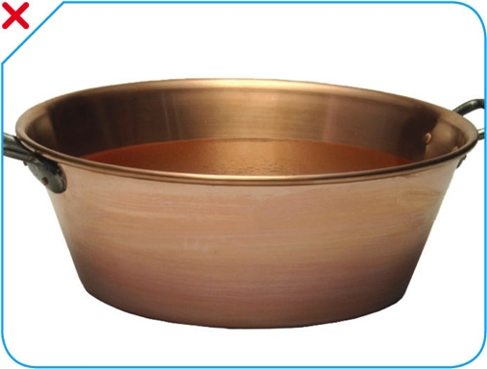
Chemical Contaminants
Sources:
Certain types of kitchenware and equipment (items made from pewter, copper, zinc, and some types of painted pottery)
Cleaners, sanitizers, polishes, machine lubricants, and pesticides
Deodorizers, first-aid products, and health and beauty products (hand lotions, hairsprays, etc.)
2-31
Notes:
Instructor Notes
Chemicals can contaminate food if they are used or stored the wrong way.
Cleaners, sanitizers, polishes, machine lubricants, and pesticides can be risks. Also included are deodorizers, first-aid products, and health and beauty products, such as hand lotions and hairsprays.
Certain types of kitchenware and equipment can be risks for chemical contamination. These include items made from pewter, copper, zinc, and some types of painted pottery. These materials are not food grade and can contaminate food. This is especially true when acidic food, such as tomato sauce, is held in them, as shown on the slide.

Slide 57
Chemical Contaminants
Symptoms:
Vary depending on chemical consumed
Most illnesses occur within minutes
Vomiting and diarrhea are typical
2-32
Notes:
Instructor Notes
If an illness is suspected, call the emergency number in your area and the Poison Control number. Consult the chemical’s Material Safety Data Sheet (MSDS), which contains important safety information about the chemical.

Slide 58
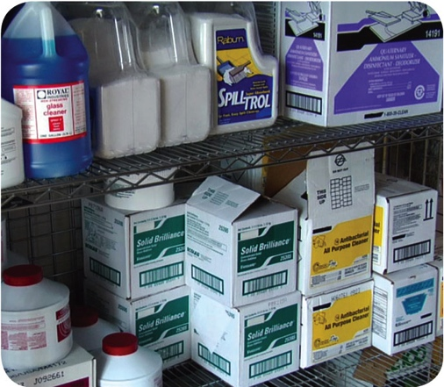
Chemical Contaminants
Prevention:
Only use chemicals approved for use in foodservice operations
Purchase chemicals from approved, reputable suppliers
Store chemicals away from prep areas, food-storage areas, and service areas
Chemicals must be separated from food and food-contact surfaces by spacing and partitioning
Chemicals must NEVER be stored above food or food-contact surfaces
Use chemicals for their intended use and follow manufacturer’s directions
2-33

Slide 59
Chemical Contaminants
Prevention:
Only handle food with equipment and utensils approved for foodservice use
Make sure the manufacturer’s labels on original chemical containers are readable
Keep MSDS current, and make sure they are accessible to staff at all times
Follow the manufacturer’s directions and local regulatory requirements when throwing out chemicals
2-34

Slide 60
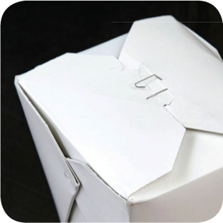
Physical Contaminants
Sources:
Common objects that get into food
Metal shavings from cans
Wood
Fingernails
Staples
Bandages
Glass
Jewelry
Dirt
Naturally occurring objects such as fruit pits and bones
2-35
Notes:
Instructor Notes
Food can become contaminated when objects get into it. It can also happen when natural objects are left in food, like bones in a fish fillet.

Slide 61
Physical Contaminants
Symptoms:
Mild to fatal injuries are possible
Cuts, dental damage, and choking
Bleeding and pain
Prevention:
Purchase food from approved, reputable suppliers
Closely inspect food received
Take steps to prevent physical contamination, including practicing good personal hygiene
2-36

Slide 62
Deliberate Contamination of Food
Groups who may attempt to contaminate food:
Terrorists or activists
Disgruntled current or former staff
Vendors
Competitors
FDA defense tool:
A.L.E.R.T.
2-37
Notes:
Instructor Notes
So far, you have learned about methods to prevent the accidental contamination of food. But you also must take steps to stop people who are actually trying to contaminate it. This may include the groups listed on the slide.
These people may try to tamper with your food using biological, chemical, or physical contaminants. They may even use radioactive materials. Attacks might occur anywhere in the food supply chain. But they are usually focused on a specific food item, process, or business.
The best way to protect food is to make it as difficult as possible for someone to tamper with it. For this reason, a food defense program should deal with the points in your operation where food is at risk.
The FDA has created a tool that can be used to develop a food defense program. It is based on the acronym A.L.E.R.T. It can be used to help you identify the points in your operation where food is at risk.

Slide 63
Deliberate Contamination of Food
Assure Make sure products received are from safe sources
Look Monitor the security of products in the facility
Employees Know who is in your facility
Reports Keep information related to food defense accessible
Threat Develop a plan for responding to suspicious activity or a threat to the operation
2-38
Notes:
Instructor Notes
Assure Make sure that products you receive are from safe sources. Supervise product deliveries. Use approved suppliers who practice food defense. Request that delivery vehicles are locked or sealed.
Look Monitor the security of products in the facility. Limit access to prep and storage areas. Locking storage areas is one way to do this. Create a system for handling damaged products. Store chemicals in a secure location. Train staff to spot food defense threats.
Employees Know who is in your facility. Limit access to prep and storage areas. Identify all visitors, and verify credentials. Conduct background checks on staff.
Reports Keep information related to food defense accessible: receiving logs, office files and documents, staff files, and random food defense self-inspections.
Threat Identify what you will do and who you will contact if there is suspicious activity or a threat at your operation. Hold any product you suspect to be contaminated. Contact your regulatory authority immediately. Maintain an emergency contact list.

Slide 64
Responding to a Foodborne-Illness Outbreak
Gather information
Notify authorities
Segregate product
Document information
Identify staff
Cooperate with authorities
Review procedures
2-39
Notes:
Instructor Notes
Here are some things you should consider when responding to an outbreak. These will be discussed in the next several slides.

Slide 65
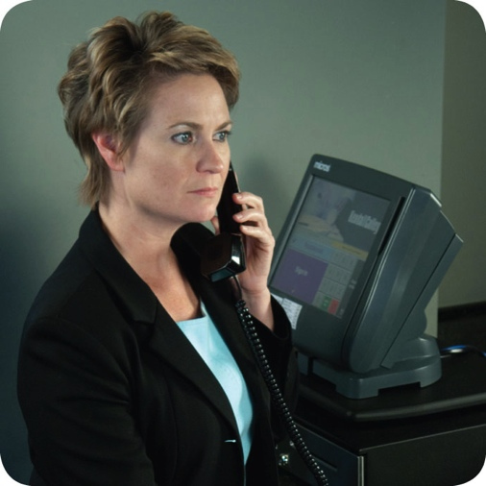
Responding to a Foodborne-Illness Outbreak
Gather information
Ask the person for general contact information
Ask the person to identify the food eaten
Ask for a description of symptoms
Ask when the person first got sick
Notify authorities
Contact the local regulatory authority if an outbreak is suspected
2-40
Notes:
Instructor Notes
Ask the person making the complaint for general contact information and to identify the food that was eaten. Also ask for a description of symptoms and when the person first got sick.
Contact the local regulatory authority if you suspect an outbreak.

Slide 66
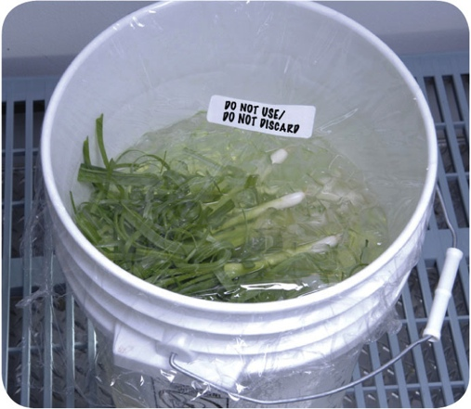
Responding to a Foodborne-Illness Outbreak
Segregate product
Set the suspected product aside if any remains
Include a label with “Do Not Use” and “Do Not Discard” on it
Document the information
Log information about suspected product
Include a product description, product date, lot number, sell-by date, and pack size
2-41
Notes:
Instructor Notes
Set the suspected product aside if any remains. Include a label with Do Not Use and Do Not Discard on it, as shown in the photo on the slide.
Log information about the suspected product. This might include a product description, production date, and lot number. The sell-by date and pack size should also be recorded.

Slide 67
Responding to a Foodborne-Illness Outbreak
Identify staff
Keep a list of food handlers scheduled at time of incident
Interview staff immediately
Cooperate with authorities
Provide appropriate documentation
Review procedures
Determine if standards are being met
Identify if standards are not working
2-42
Notes:
Instructor Notes
Maintain a list of food handlers scheduled at the time of the suspected contamination. These staff members may be subject to an interview and sampling by investigators. They should also be interviewed immediately by management about their health status.
Cooperate with regulatory authorities in the investigation. Provide appropriate documentation. You may be asked to provide temperature logs, HACCP documents, staff files, etc.
Review food-handling procedures to identify if standards are not being met or procedures are not working.

Slide 68
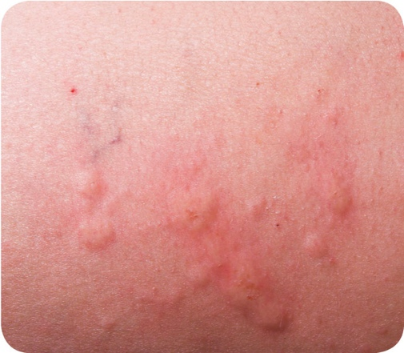
Food Allergens
Food allergen:
A protein in a food or ingredient some people are sensitive to
These proteins occur naturally
When an enough of an allergen is eaten, an allergic reaction can occur
2-43

Slide 69
Food Allergens
Allergy symptoms:
Nausea
Wheezing or shortness of breath
Hives or itchy rashes
Swelling of the body, including the face, eyes, hands, or feet
Vomiting and/or diarrhea
Abdominal pain
Allergic reactions:
Symptoms can become serious quickly
A severe reaction, called anaphylaxis, can lead to death
2-44
Notes:
Instructor Notes
Depending on the person, an allergic reaction can happen just after the food is eaten or several hours later. This reaction could include some or all of the symptoms identified in the slide.
Initially symptoms may be mild, but they can become serious quickly. In severe cases, anaphylaxis—a severe allergic reaction that can lead to death—may result.
If a customer is having an allergic reaction to food, call the emergency number in your area.

Slide 70
Food Allergens
Common food allergens:
Milk
Eggs
Fish
Shellfish, including lobster, shrimp, and crab
Wheat
Soy
Peanuts
Tree nuts, such as almonds, walnuts, and pecans
2-45
Notes:
Instructor Notes
Many food items can cause an allergic reaction. You and your staff must be aware of the most common food allergens and the menu items that contain them.
The food items listed in the slide are responsible for the majority of food allergies and can cause severe allergic reactions.

Slide 71
Prevent Allergic Reactions
Service staff:
Describe how the dish is prepared
Identify ingredients
Suggest simple menu items
Hand-deliver food to customers with food allergies
2-46
Notes:
Instructor Notes
Your staff should be able to tell customers about menu items that contain potential allergens. At minimum, have one person available per shift to answer customers’ questions about menu items. When customers say they have a food allergy, your staff should take it seriously.
Tell customers how the item is prepared. Sauces, marinades, and garnishes often contain allergens. For example, peanut butter is sometimes used as a thickener in sauces or marinades. This information is critical to a customer with a peanut allergy.
Identify any “secret” ingredients. For example, your operation may have a house specialty that includes an allergen. While you may not want to share the recipe with the public, staff must be able to tell the secret ingredient to a customer who asks.
Suggest simple menu items. Complex items such as casseroles, soups, and some desserts may contain many ingredients. These can be difficult to fully describe to customers.
Food should be hand-delivered to guests with allergies. Delivering food separately from the other food delivered to a table, as shown in the photo on the slide, will help prevent contact with food allergens.

Slide 72
Prevent Allergic Reactions
Kitchen staff:
Avoid cross-contact
Do NOT cook different types of food in the same fryer oil
Do NOT put food on surfaces that have touched allergens
2-47
Notes:
Instructor Notes
Staff must make sure that allergens are not transferred from food containing an allergen to the food served to the customer. This is called cross-contact.
Cooking different types of food in the same fryer oil can cause cross-contact. In the photo on the slide, shrimp allergens could be transferred to the chicken being fried in the same oil.
Putting food on surfaces that have touched allergens can cause cross-contact. For example, putting chocolate chip cookies on the same parchment paper that was used for peanut butter cookies can transfer some of the peanut allergen.

Slide 73
Prevent Allergic Reactions
Kitchen staff:
Avoid cross-contact
Wash, rinse, and sanitize cookware, utensils, and equipment after handling an allergen
Wash your hands and change gloves before prepping food
Prep food for customers with food allergies in a separate area from other food
Label food packaged on-site for retail use
2-48
Notes:
Instructor Notes
Wash, rinse, and sanitize cookware, utensils, and equipment after handling a food allergen. For example, the tongs used to sauté a dish containing slivered almonds in the photo are then washed, rinsed, and sanitized before being reused.
Label food packaged on-site for retail sale. Name all major allergens on the label and follow any additional labeling requirements.

